Slide 1
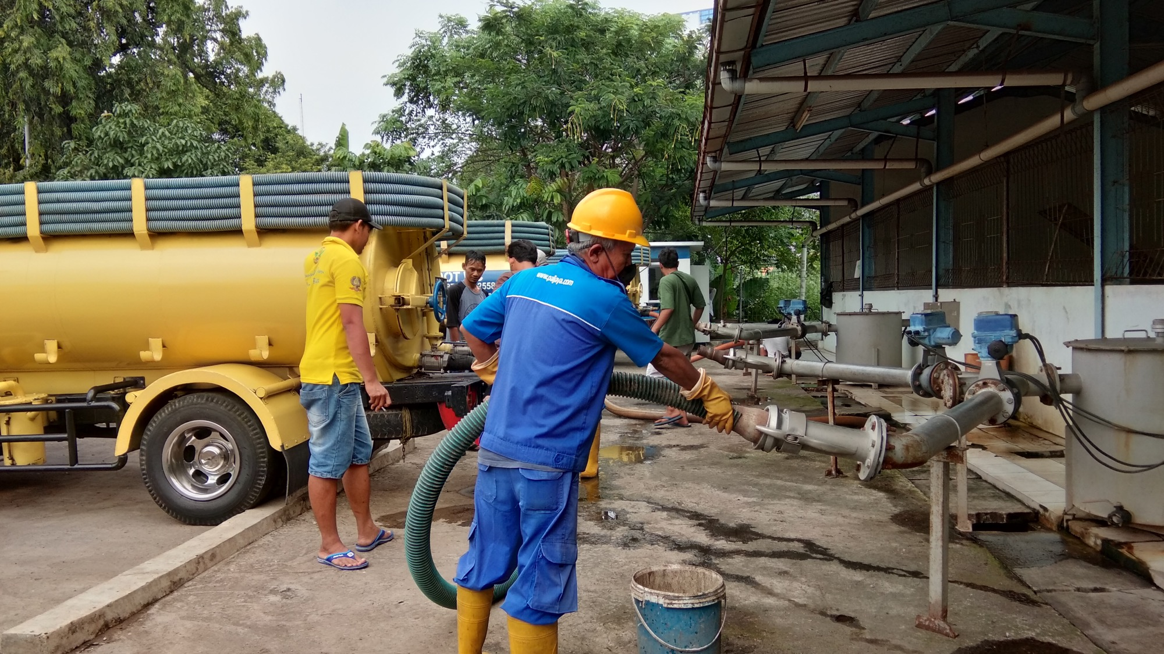


Faecal sludge and wastewater treatment technologies in practice: a case study review across four countries.
Authors: Simone Soeters, Pierre Mukheibir, Juliet Willetts, Freya Mills (Institute for Sustainable Futures- University of Technology Sydney, Sydney), Antoinette Kome, Rajeev Munankami (SNV Netherlands Development Organisation)

Slide 2
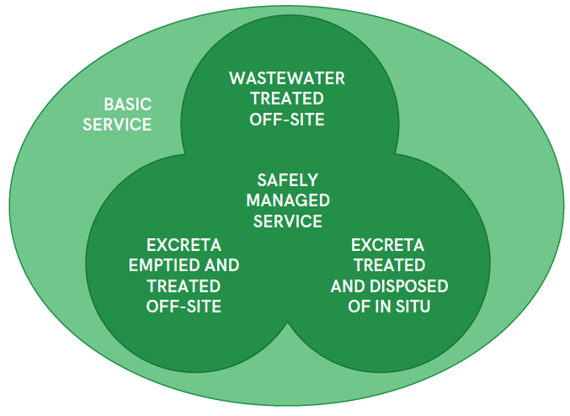
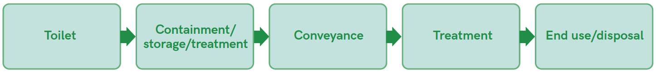
Context and rationale
In 2017, only 45% of the global population (3.4 billion people) used safely managed services.
Safely managed implies safe management of excreta at each step of the sanitation service chain → Need to advance treatment, re-use/end use and disposal steps
Existing guidance on faecal sludge management (FSM) processes primarily technical → need research that shares how these processes work in reality
Safely managed services pathways. Source: JMP, 2019
Sanitation service chain. Source: WHO, 2018
Notes:
SDG criteria for safely managed means households must use an improved type of sanitation facility that is not shared with other households and the excreta produced must either be safely treated in situ, or transported and treated off-site.
In practice, there are three possible pathways to safely managed services:
• Wastewater treated offsite: excreta are conveyed with wastewater through sewer lines and treated off-site at wastewater treatment plants
• Excreta emptied and treated off-site: excreta are emptied from septic tanks and latrine pits, removed and treated offsite at facilities designed for faecal sludge
• Excreta treated and disposed of in situ: excreta are treated and disposed of in situ in septic tanks with appropriate leachfields, or in latrine pits that are covered and left undisturbed when full.
(JMP, 2019)

Slide 3
Research objectives and methodology
Objectives
Outline the practices of selected faecal sludge and wastewater treatment, disposal and reuse technologies in low-resource setting countries
Make accessible the experiences, operational realities and decisions in treatment and disposal options, to facilitate improved informed choice of treatment technologies
Methodology
Literature review of treatment technologies
Semi-structured qualitative interviews with operators and designers of selected treatment technologies
Notes:
Ongoing research project with emerging findings
Objectives
real-world implementation and use of selected technologies
Methodology
Semi-structured interviews (in person and remotely)

Slide 4
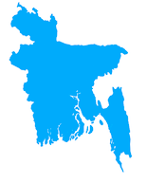
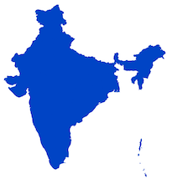



Background to the research
Research partnership between ISF-UTS and SNV Netherlands Development Organisation
Highlight on four case study countries:
Bangladesh
Constructed wetlands
Coco peat filters and reuse production of soil conditioners
India
Deep Row Entrenchment
Indonesia
Conventional and mechanized faecal sludge treatment
Kenya
Briquette production
Black Soldier Flies
Notes:
ISF-UTS (leading on design, analysis, some remote interviews and writing) and SNV Netherlands Development Organisation (SNV country offices conducting semi-structured qualitative interviews with operators and designers of treatment technologies)

Slide 5
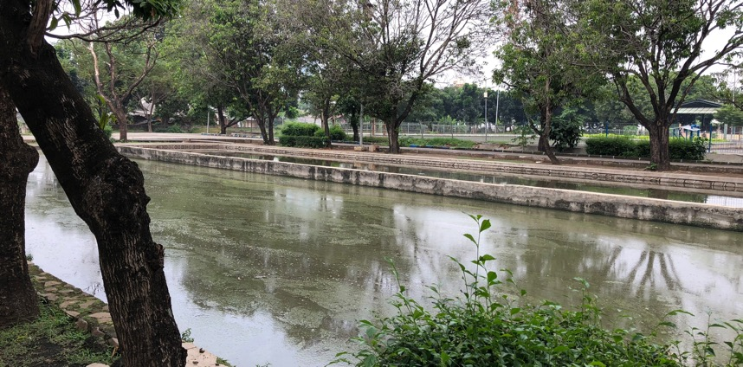
Indonesia: faecal sludge treatment processes
Duri Kosambi FSTP in Jakarta operated by PD PAL
Conventional, mechanized and Andrich systems operating in parallel
Conventional system built in 1983 and mechanized system built in 2013.
Design capacity is 900 m3/day (conventional system = 300m3/d and mechanical system = 600 m3/d), currently operating at 140-200 m3/d
Conventional system used more frequently than mechanical system. Operating cost (energy, chemicals) cheaper.
Exploring briquettes as reuse options due to treated sludge piling up as landfill
SNV Indonesia, conventional maturation pond
SNV Indonesia, conventional maturation pond
Block Flow Diagram of Duri Kosambi
Notes:
PD PAL- city owned sewerage company
Andrich system = treatment system being trialed at Duri Kosambi. Andrich is named after two Indonesian engineers that developed the system. It is basically a Nanofiltration Membrane Unit which is equipped with Dissolved Air Flotation (DAF) as a pre-treatment system.

Slide 6
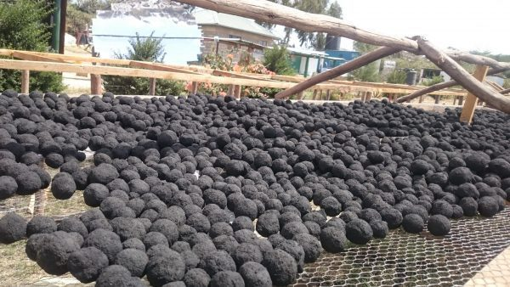
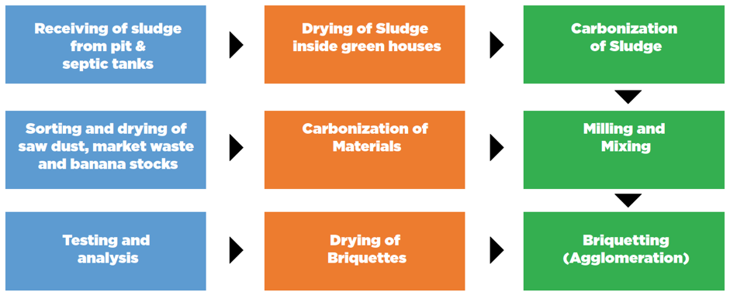
Kenya: briquettes for faecal sludge reuse
Briquette production by NAWASSCOAL in Nakuru since 2018
10t of briquettes produced / month and used as alternative fuel source for cooking and heating
Receive sludge via sewer connection from mother company NAWASSCO (conventional wastewater treatment plant)
Construction financed through EU co-funded project and loans from NAWASSCO
Key challenge for first three years is to break even as per business plan
Round-shaped carbonized briquettes
Briquette production process
Notes:
Carbonization involves conversion of organic substances (sludge, banana stalks and market waste) into carbon or a carbon-containing residue through pyrolysis (decomposition brought about by high temperatures) or burning under limited oxygen supply.

Slide 7
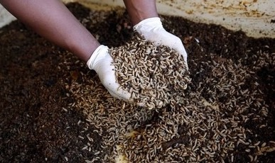
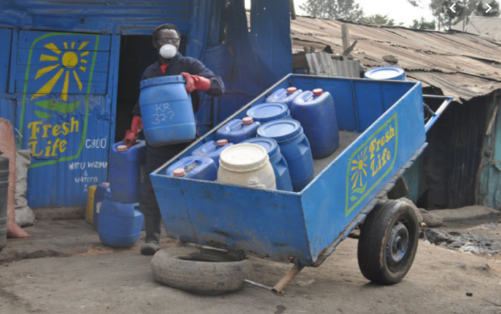
Kenya: Black Soldier Flies for faecal sludge treatment and reuse
Use of Black Soldier Fly’s by Sanergy in urban, non-sewered areas in Nairobi for treatment and production of agricultural products
  organic fertilizer, insect-based animal feed and fuel briquettes
7t of waste (sludge and organic waste) safely managed everyday expanding to 200t by 2020
Sanitation waste collected form the FreshLife toilets, with customers paying a subscription for the toilet and regular, professional waste collection services
Strong partnership with government and municipalities needed
Black Soldier Fly larvae
FreshLife toilets. Source Sanergy
Notes:
Sanergy, founded in 2011, manages and upcycles organic waste – sanitation waste, agricultural waste, and market / kitchen waste – into agricultural inputs: organic fertilizer through thermophilic composting and insect-based animal protein meal through the rearing of Black Soldier Fly Larvae. Sanergy also converts the waste into briquettes through pyrolysis creating an eco-friendly, renewable fuel source.

Slide 8
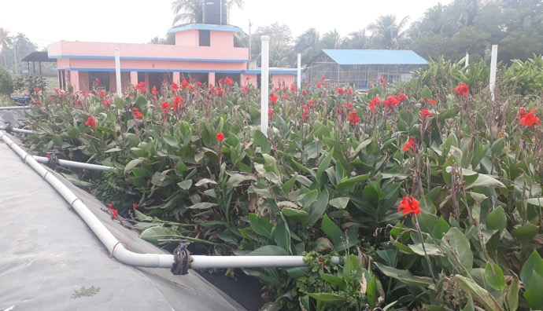
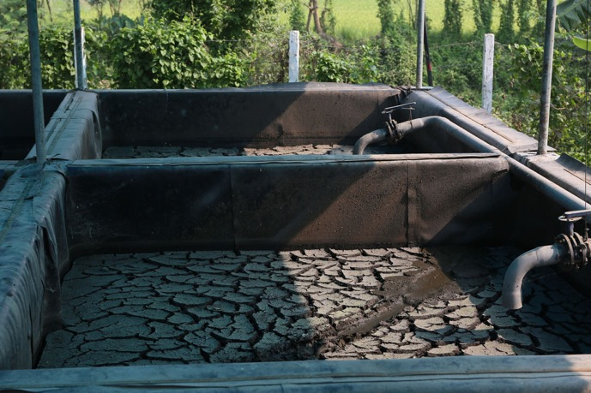
Bangladesh: constructed wetlands for faecal sludge treatment
Khulna City Corporation FSTP, using constructed wetlands and sludge drying beds
Capacity of 180 m3/day, currently only 10 m3/day of sludge collected and processed /day
No mechanical treatment occurring or chemicals used, treatment plant is aerobic with waste going directly to constructed wetlands
Treated liquid waste is discharged in surrounding surface water body
Reuse of solid sludge after drying is under R&D briquette production
Constructed wetlands, Khulna. Source: SNV
Sludge drying beds, Khulna. Source: SNV
Notes:
Khulna: with no mechanical treatment occurring- treatment plant is aerobic with waste going directly to constructed wetland. No chemical substances are mixed into the waste as they have no issue with smell or the end product affecting the environment.

Slide 9
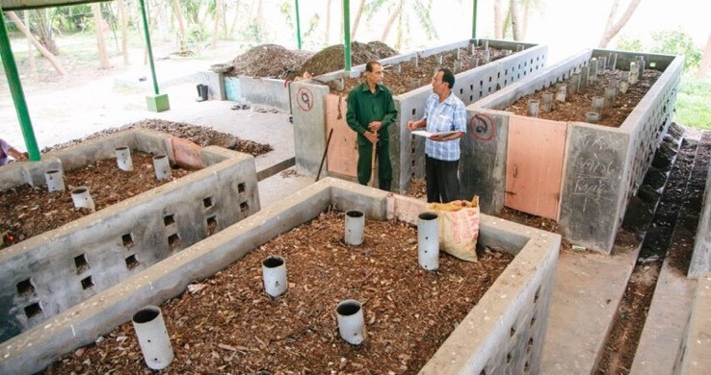
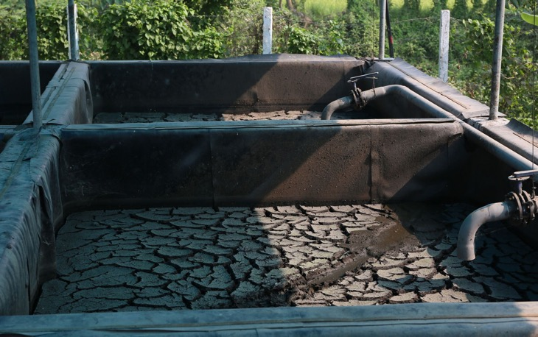
Bangladesh: cocopeat filters and reuse
Kushtia FSTP with two sludge drying beds each with a capacity of 8 - 9 m3 / day
Use cocopeat filters (discarded dust and coir generated from coconut processing plants) to filter effluent waste water
Main concern in selecting design was costing (capex and opex)- mechanical system was not feasible
Solid dried sludge used for co-compost production and treated liquid waste discharged into adjacent canal
Co-compost in Kushtia, Source: Aidan Dockery, SNV
Sludge drying beds in Kushtia, Source: Aidan Dockery, SNV
Notes:
Using a cocopeat filter, the discarded dust and coir generated from coconut processing plants, an effective bio-filter unit can be constructed. This simple device can easily be connected to existing septic tanks or other primary treatment components to filter effluent waste water
Need to build up emptying services so that there will be more sludge

Slide 10
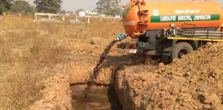
India: faecal sludge disposal
Deep Row Entrenchment as disposal option for faecal sludge in Odisha, India
Trench dimensions: 1.5m wide, 3m deep, 10m long
No pre-treatment of sludge from septic tanks (2-3 years in septic tanks)
Six-months to fill one trench
Considered a temporary disposal solution only as Odisha moves towards construction of FSTP for all towns
Ernst & Young, truck offloading FS into a deep row trench
Notes:
Once filled, trench is covered and in some cases trees planted

Slide 11

Challenges and realities
Screening of rubbish
Low quality of sludge at the Duri Kosambi FSTP from septic tanks due to rough sands, trash and grease being thrown in latrine, similar at the Kushtia FSTP.
Intended capacity vs. reality
Khulna FSTP only using 5% of capacity and Duri Kosambi FSTP only using 25% of capacity.
Environmental considerations
Site selection crucial for DRE in India, can not use trenches in areas that experience flooding, inundation or have sandy soil or during monsoon period
Power failures & weather
Power outages and lack of back up generators can delay briquette production for NAWASSCOAL, with poor weather sometimes delaying drying of sludge & final product
OH&S challenges
Due to manual sorting of organic matter from solid waste at the Kushtia FSTP, staff were frequently cut by metal scraps.
Variability of waste input
Kushtia FSTP experienced variable waste input leading to operational challenges
Notes:
Screening of rubbish
Duri Kosambi treat this issue by using additional chemicals which increases production costs and rough sands can damage machines
Kushtia FSTP: Quality of sludge is not consistent. Time and labour requirement increases due to cleaning of foreign and unwanted materials resulting increase in production cost.
Some countries in Africa starting to charge differently for poor quality sludge
Intended capacity vs. reality
Khulna wastewater treatment plant scale was too large (only using 5% of capacity). Should have staged the development and investment incrementally. Similar to Duri Kosambi FSTP, only using 25% of capacity→ people have septic tanks that seep rather than fill and awareness of any need to empty is low. So it is something they are addressing through various means both themselves and in partnership with other sector actors, but one which is not yet solved.
Environmental considerations
Flooding, inundation or have sandy soil (risk contaminating groundwater(
Power failures and weather
Introduction of covered solar driers assisting with this
O&H Challenges
manual sorting of solid waste (to extract organic matter for co-composting with faecal sludge), staff are frequently cut by metal scraps. This is despite OH&S measures mandated including use of boots, gloves and handwashing with anti-bacterial soap
Variability of waste input
If the input is low, then end product production is less. If input is high, the plant cannot handle the excess amount and discharged in trench which may cause environmental pollution.

Slide 12
Key messages from case study countries
How to plan and match to your treatment capacity in a changing space concerning faecal sludge emptying? Behaviour and containment technologies affect the quantity and quality of input sludge
Until faecal sludge treatment plants are fully functional and existing, safe disposal options are still needed. Options including deep row entrenchment can be an interim measure
Reuse options (e.g. briquettes, co-compost/fertilizers and insect based animal feed) increasingly being trialled and used both to ensure safe disposal in last step of chain, as well as potential for resource recovery and associated revenue

Slide 13

Thanks to SNV, interviewees and you!
Simone Soeters
Research Consultant
simone.soeters@uts.edu.au
Institute for
Sustainable Futures
isf.uts.edu.au

