Slide 1
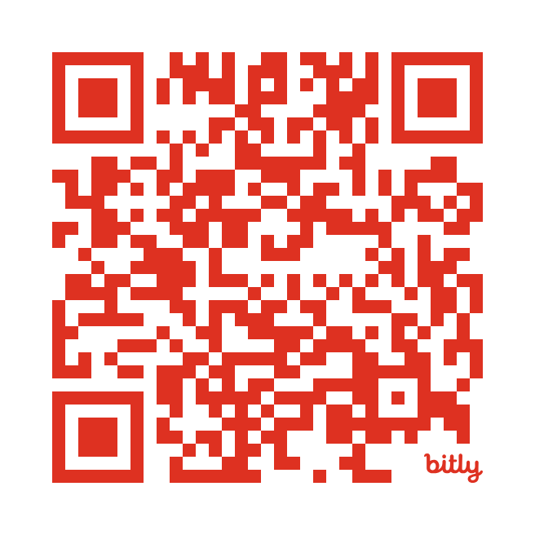
Cancer Symptom Trials (CST) Membership
Who can apply
consumer advocates and community members, health professionals, cancer researchers, health economists, biostatisticians, industry representatives, and other professionals interested in cancer research
Why apply
collaboration and research
news and events
committee membership
How to apply
Online at www.uts.edu.au/cst/membership

