Slide 1
UTS HELPS
How to Write a
Reflective Paper

Slide 2
Workshop Objectives
To understand the genre of reflective writing in terms of purpose, language and structure
To learn the essential stages of reflective writing
To become a reflective practitioner in your current studies and future field

Slide 3
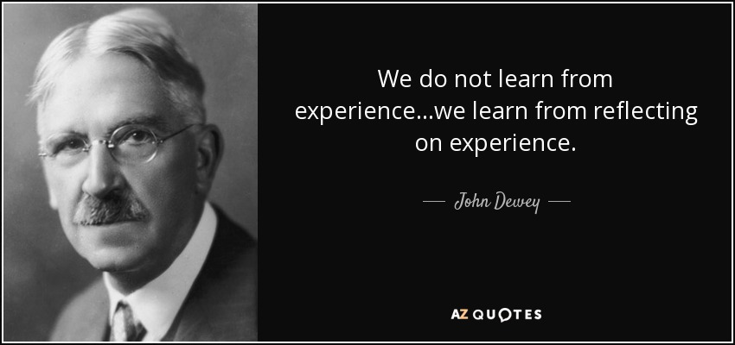
Source: http://www.azquotes.com/quote/497608

Slide 4
Activity / Discussion
Think of an interaction, event or episode you experienced that can be connected to a topic of study or theme in your course……
Describe what happened
What was your role?
What feelings and perceptions surrounded the experience?
How would you explain the situation to someone else?
What might this experience mean in the context of your course?
What other perspectives, theories or concepts could be applied to the situation?

Slide 5
Reflective Essays / Journals
Unique genre
Based on feelings/experiences
Becoming more common
Part of PD and life long learning
Have no ‘right’ answer
Identify changes and improvements
Identify strengths and weaker areas
Notes:
A very different writing genre
Not based on given content but on your feelings and experiences
Becoming more common across all UTS faculties
An important part of PD and life long learning
Has no ‘right’ answer; marks are usually based on your honesty and depth of self-analysis
Identifies what changes and improvements you will make to your practices
Identifies your strengths and weaker areas so that you know what:
to keep doing
to stop doing
to start doing

Slide 6
What is Reflective Writing?
Maps the progress and changes in your thinking about a subject or a topic, or about the learning journey in which you have engaged.
Notes:
Generally, a reflective piece of writing requires you to map the progress and changes in your thinking about a subject or a topic, or about the learning journey in which you have engaged.
To reflect (verb) = to think deeply about / to carefully consider.
Writing a reflective piece of writing may include some of the following:
You may be asked to make regular entries in a journal (over a period of time), which will then have to be submitted and assessed. You may also be asked to use your reflections built up over a period of time as the basis of an essay or a report.
If the journal is to be assessed, it should be well structured and clearly expressed for the benefit of your audience, even though it may have elements of personal writing.
If the journal is for yourself and is to be used as the basis of an essay or a report, make sure that your writing will make sense to you when you refer to it to compose your essay or report.

Slide 7
Why do lecturers set reflective assignments?
Lecturers ask you to write reflectively for a range of reasons:
To examine your learning processes
To make connections
To think carefully
To clarify your understanding
To learn from mistakes and lessons
To become an active learner
To encourage you to become a reflective
Source: http://learnonline.canberra.edu.au/mod/book/view.php?id=180720&chapterid=463
Notes:
Lecturers ask you to write reflectively for a range of reasons:
To examine your learning processes, including not only what you have learnt, but how you learnt it.
To make connections: between what you already know and what you are learning; between theory and practice; between course material and personal experiences.
To think carefully about what you are doing, how you are doing it, and why you are doing it.
To clarify your understanding – identifying the questions you have, and what you have yet to learn.
To learn from mistakes and lessons: avoid repeating mistakes and identify successful principles and strategies to use again.
To become an active learner: engage in the learning process by asking questions, raising doubts, and thinking critically about one's own ideas.
To encourage you to become a reflective practitioner in your future field. This is the key to life-long learning, growth and meaningful change.

Slide 8
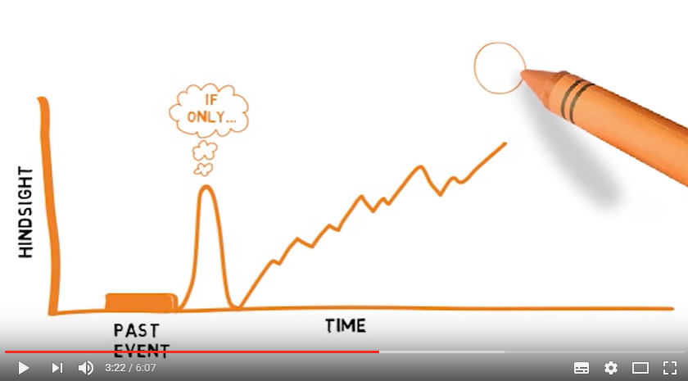
Reflective Writing Video
https://www.youtube.com/watch?v=QoI67VeE3ds
(Click on the image on the left to go directly to the video)

Slide 9
What would I be asked to reflect on?
A practical learning experience within the course Clinical placement in nursing Teaching practicum in education Community project in pharmacy Field experience in counselling Classroom observation in TESOL Group project in design | A review of your learning in a course or unit Your perceptions of the course and the content Comparisons and connections between what you are learning and your prior knowledge An analysis of developments in your assumptions, values, beliefs and attitudes
A response to a text Your understanding of the main ideas What you agree or disagree with How the main ideas are relevant to those in other readings | A past experience Learning a second language Encountering a foreign culture

Slide 10
Writing Style
Subjective, reflective, logical, personal, hypothetical, critical and creative
Includes some description, explanation, analysis and self-expression
Can use personal pronouns
Minimally colloquial language
Source: https://student.unsw.edu.au/how-do-i-write-reflectively
Notes:
As it concerns your thoughts, reflective writing is mostly subjective. Therefore, in addition to being reflective and logical, you can be personal, hypothetical, critical and creative. You can comment based on your experience, rather than limiting yourself to academic evidence.
Reflective writing is an activity that includes description (what, when, who) and analysis (how, why, what if). It is an explorative tool often resulting in more questions than answers.
A reflective task may allow you to use different modes of writing and language:
descriptive (outlining what something is or how something was done)
explanatory (explaining why or how it is like that)
expressive (I think, I feel, I believe)
Use full sentences and complete paragraphs
You can usually use personal pronouns like 'I', 'my' or 'we'
Keep colloquial language to a minimum (eg, kid, bloke, stuff)

Slide 11
How do I start my reflective writing?
Some guiding questions for reflective thinking are:
What happened during that event or experience? And why did it happen?
What was my role in the event? And why did I adopt that particular role?
What were my feelings during that experience? And why did I feel that way?
What were my thoughts during that experience? And why did I think that way?
How do I interpret what I experienced or observed?
What might this experience mean in the context of my course?
What other perspectives, theories or concepts could be applied to interpret the situation?
How can I learn from this experience?
Source: http://www.deakin.edu.au/students/studying/study-support/academic-skills/reflective-writing
Notes:
You base your reflective writing on a reflective thinking process. And the reflective process starts with yourself.
Reflection involves taking a pause to examine your own thoughts, beliefs, values, attitudes and assumptions, which form the foundation of your understanding. Revisit your prior experiences and knowledge, and consider how you think and why you think the way you do. There is no absolute right or wrong way of reflective thinking but the key questions in reflective thinking are often how and why.

Slide 12
A Simple Model for Reflection
What?
So What?
Now What?
Adapted from: Rolfe, G., Freshwater, D., & Jasper, M. 2001, Critical reflection for nursing and the helping professions: a user’s guide, Palgrave Macmillan, Basingstoke.

Slide 13
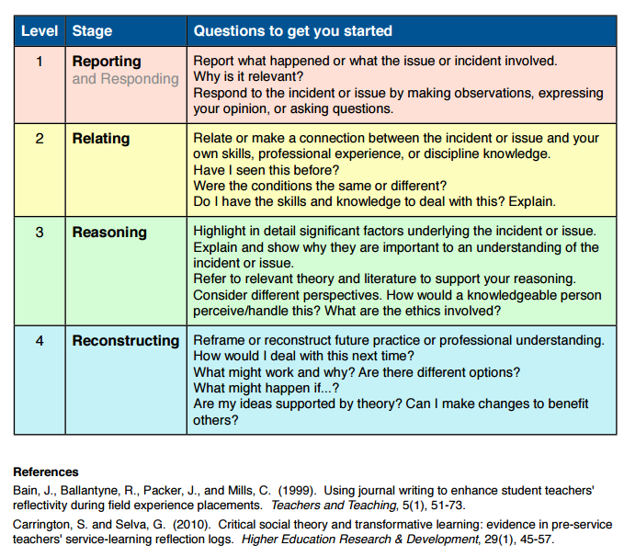

Slide 14
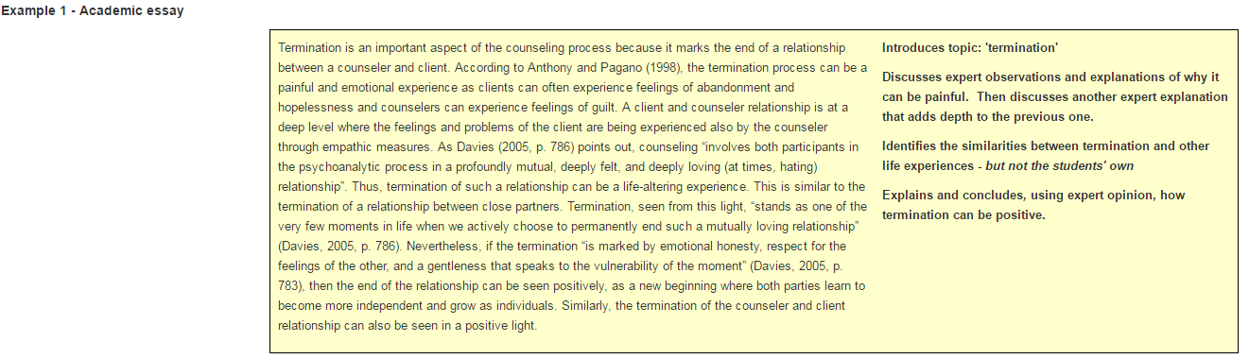
Examples of Reflective Writing
http://learnonline.canberra.edu.au/mod/book/view.php?id=180720&chapterid=470

Slide 15
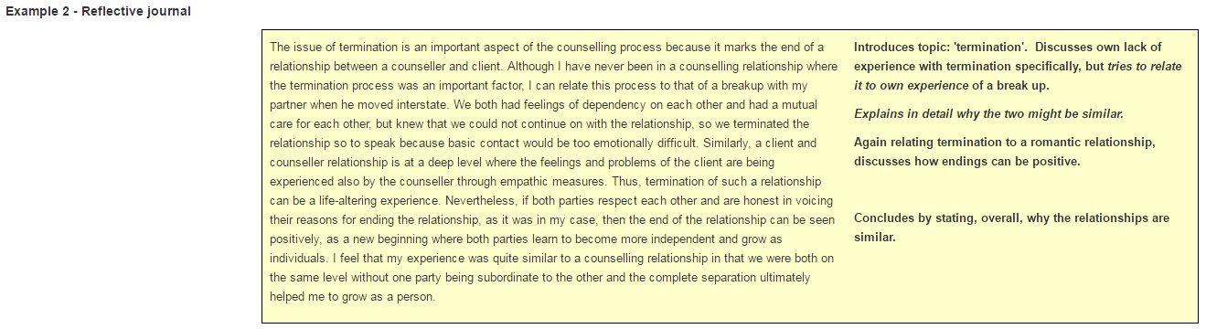
http://learnonline.canberra.edu.au/mod/book/view.php?id=180720&chapterid=470

Slide 16
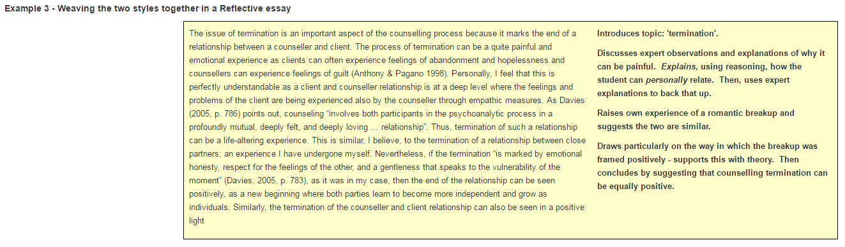
http://learnonline.canberra.edu.au/mod/book/view.php?id=180720&chapterid=470

Slide 17
Checklist for Reflective Writing
Have I:
Reported (described) the issue or experience upon which I am reflecting?
Explained the relevance of the issue or experience to my future professional practice?
Described my own response to the experience?
Reasoned about the significant factors in the situation (using academic literature/theory)?
Outlined how the issue or experience changed my understanding and/or behaviour?
Explained how this new understanding will help to reconstruct my future professional practice?
Followed the required structure for this assignment?
Checked that my assignment makes sense?
Checked that my spelling and punctuation are error free?
Source: http://www.citewrite.qut.edu.au/write/reflectivewriting.jsp

Slide 18
Reflective Writing Language
In writing your reflective paper, it is useful to use ‘reflective phraseology’ in your response. Some examples may be:
In your response, ensure that you are analysing and reflecting on what you have learnt, and not simply describing what you have done.
  Upon reflection, it was observed that…
  In reflecting upon the tutorial exercise, it was useful to observe…
  To reflect upon the learning process this semester, it can be argued that several factors influenced…
  These observations are consistent with the case study conducted by Sotir (2016) in which…

Slide 19
Consider the following when writing a reflective journal:
Describe the events and your experience – what did I do/hear/see?
Interpret and evaluate the events from your perspective – what do I think about it now? How does it relate to other things that I know? Explain your experience; reveal your new insights, connections with other learning, your hypotheses, and your conclusions.
Reflect on how this information will be useful to you – what questions do I have? Have I changed how I think about the situation? Where do I go from here?
If you have been given specific questions or tasks to perform, use these as headings to help organise your writing.

Slide 20
Questions to help you hone your reflective writing skills:
What have I learnt from this process?
What do I ‘now know’ that I did not before?
What insights have I gained?
What are my / the perceived strengths and weaknesses that I have observed?
What were the challenges I have encountered / observed and how well did I / my team handle them?
What would I do better next time and with what anticipated results?
What theory proved to be useful and why?

Slide 21
Activity (refer to handout)
Task 1
Consider a professional or academic situation that required an analysis of the underlying cause of an issue. This could be a personal or study situation, or one you have experienced in your own work practice.
Write down questions that will help you uncover the underlying patterns, motives and reasons for the situation using the ‘what’ and ‘so what’ structure or model.
Task 2
Now consider what this means for the next steps and the way you move forward: ask 'now what?‘
Write down your thoughts and reflections. What have you learned?
Is the model for reflection (i.e. What? So What? Now What?) a useful tool?
How else might you use it in a professional role in the future?

Slide 22
Extra Activity – reflecting on your experience of today
 | Simple sentence beginnings…
WHAT have you learned today? | I learned that …
SO WHAT does this mean to you about how you write? | This means I need to improve/change…
NOW WHAT? – what will you do differently next time you write? | In the future, I will …

Slide 23

HELPS Website
(Click on the image on the left to go directly to the web page)
http://www.uts.edu.au/currentstudents/ support/helps/self-help-resources/academic-writing/reflective-writing

Slide 24
Discover these!
Online self-help learning resources
Drop-in & 1:1 consultations
Conversations@UTS
Intensive Academic English Programmes
Daily Workshops
Volunteer Programmes
 www.helps.uts.edu.au

Slide 25
UTS HELPS
 9514 9733
 helps@uts.edu.au
 www.helps.uts.edu.au
.

