Slide 1
UTS HELPS
Giving Effective Presentations

Slide 2
Workshop Objectives
To assist in planning all aspects of your presentation.
To examine methods of engaging your audience.
To discuss strategies for delivering presentations confidently.
UTS HELPS Bootcamp 2020

Slide 3
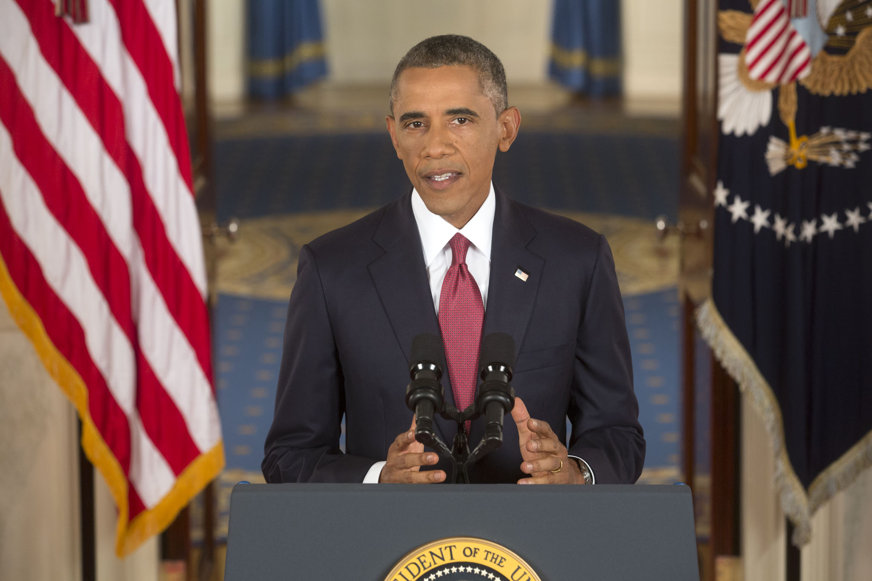
Do you think he is a skilled speaker?
Image source: Obamawhitehousearchives.gov
Notes:
Ask why

Slide 4
Watch the following TED Talk
What do you think the presenter does well?
What doesn’t the presenter do well?
Sir Ken Robinson: Do Schools Kill Creativity?
Notes:
TED talk – group analysis
Sir Ken Robinson: Do Schools Kill Creativity? – up to 2 minutes. After the first 2 minutes, stop the video and put student into break out rooms to discuss what they thought was good and bad about this presenter

Slide 5
Good aspects
He uses a lot of humour
He tells engaging stories
He asks direct questions to his audience
Bad aspects
He sometimes mumbles
He uses nervous gestures
He sometimes stumbles over his words or speaks too quickly
Notes:
An important point to make is that no-one is a perfect presenter. This is the most watched TED talk of all time but he breaks some key rules of presenting. BUT he still engages through his stories, use of humour, and the conviction and passion he has about his ideas

Slide 6
Before you start

Slide 7
1. Define the purpose
What is the overarching aim?
Who is the audience?
What are the marking criteria?
Notes:
The structure
The content
Choices about the language you use
Choices regarding visuals, software and platform
At university your main audience is your teacher, although your teacher will be taking note of how well you can engage your classmates as you present to them.
In your professional life, your audience may be clients (or potential clients), customers, colleagues, managers, shareholders etc. You need to think about who they are and how that will affect the way you try to relate to them (e.g. how formal do you need to be? How much do they already know?).
You should ALWAYS be aware of the assignment task and marking criteria as this will determine your response to each assessment.

Slide 8
The purpose in a professional context
To instruct
e.g. airline emergency demonstrations
To inform
e.g. An update to company management on your team’s sales performance
To persuade
  e.g. a sales pitch to a prospective client
To motivate
  e.g. public health messages to encourage healthy eating
Notes:
To instruct – to tell people what to do
To inform – to tell people about an idea or product. Data is likely to be useful in this case.
To persuade – to sell an idea or a product. Data is only useful if it is part of a story that explains why the idea or product is useful. In this case you first need to sell the problem (i.e. convince people that it’s both real and problematic), and then sell the solution
To motivate – to encourage a change in behaviour. Stories are the most powerful form of motivation, especially stories that show how similar behavioural change has improved the lives of others.

Slide 9
2. Consider your take-away
What is the main idea you want the audience to remember afterwards?
What will support them to remember this?
Notes:
What are the key points you want them to know?
Most of what you tell your audience will be forgotten within 24 hours of your presentation (or even earlier). So what is the one thing you really want them to remember? Focus on that and make it memorable (e.g. through repeating it several times or by using a really interesting example or emotional story).
What will best help them understand it?
You may need to personalize the information – ensure that they understand how it is relevant to them.
Statistics? Stories? Examples? Case studies?

Slide 10
3. Consider delivery
Face-to-face or online?
Individually or in a group?
Using slides or simply speaking?

Slide 11
Structuring your content

Slide 12
Introduce yourself
State the purpose of the presentation
Outline what will be in the presentation
Introduction

Slide 13

Consider starting with a hook
Make a provocative statement
Tell a story
Tell a surprising statistic
Ask a question
Begin with a captivating visual
Notes:
https://visme.co/blog/how-to-start-a-presentation/

Slide 14
Activity
Watch the first 2 minutes of this TED Talk by Simon Sinek.
What is his hook? How does he link the hook to the topic of his presentation?
Notes:
https://www.ted.com/talks/simon_sinek_why_good_leaders_make_you_feel_safe?language=en#t-125121
Dan Pink – up to 1minute 36: https://www.ted.com/talks/dan_pink_the_puzzle_of_motivation?referrer=playlist-the_most_popular_talks_of_all
Kelly McGonigal up to 1 minute 10: https://www.ted.com/talks/kelly_mcgonigal_how_to_make_stress_your_friend?referrer=playlist-the_most_popular_talks_of_all&language=en#t-68315

Slide 15
Activity
What is his hook? How does he link the hook to the topic of his presentation?
Hook 1. He tells a story about a very dramatic moment.
Hook 2. He poses questions that link the story to the main point he wants to make.
Notes:
https://www.ted.com/talks/simon_sinek_why_good_leaders_make_you_feel_safe?language=en#t-125121
Dan Pink – up to 1minute 36: https://www.ted.com/talks/dan_pink_the_puzzle_of_motivation?referrer=playlist-the_most_popular_talks_of_all
Kelly McGonigal up to 1 minute 10: https://www.ted.com/talks/kelly_mcgonigal_how_to_make_stress_your_friend?referrer=playlist-the_most_popular_talks_of_all&language=en#t-68315

Slide 16
More examples of hooks…
"Today, you will learn something that will add 10 years to your life.”
"20 years from now, your job won't exist.”
"Did you know that more people have access to a mobile phone than a toilet?”
Source: https://visme.co/blog/how-to-start-a-presentation/

Slide 17
ACTIVITY
What hook might you use for a presentation about global warming?

Slide 18


One example of a hook…
Last summer, bushfires in Australia burnt out an area of forest larger than the size of England.
An estimated one billion animals were killed by these fires.

Slide 19
Body
What will your main points be?
What sequence will they go in?
How will you support them?

Slide 20

Chronological structure
First, we constructed a hypothesis
Then, we conducted the experiment.
Next, we analysed the data
Finally, we drew conclusions
Image source: flickr.com
Notes:
Example of chronological structure (for a slide, but the entire presentation, or a section of it, may follow this same structure).

Slide 21
Categorical structure
 | Battery Electric Vehicles | Plug-in Hybrid Electric Vehicle | Hybrid Electric Vehicles (HEV)
Source of Power | Fully-electric vehicles | Recharge battery through braking and “plugging in” | Powered by both gasoline and electricity.
Advantages | Do not emit any harmful emissions | Go 40 miles before engine assistance | Energy generated by the car’s own braking system
Examples | Tesla Model 3 BMW i3 | Chrysler Pacifica Ford C-Max Energi | Honda Civic Hybrid Toyota Camry Hybrid
Notes:
Example of a category structure. Again, this structure could be used for an entire presentation, or a section of one, rather than just a single slide.

Slide 22
Cause and effect structure
Common for business or nursing case studies and essays that explain how something happened
Often starts by describing a situation or event, then explaining how and why it happened.
May also require recommendations about how to avoid it happening again in future.

Slide 23
Problem-solution structure
Outlining a problem and then suggesting proposed solutions.
Common for proposals in Engineering, IT and Design.
The key is to make it clear why the problem is so serious, and why your proposed solution is likely to be effective.
Notes:
Cause and effect You can adopt this method whenever there exists a cause and effect relationship. Here you have to illustrate and explain the causes of the situation and then focus on the effects. It is relevant for topics like ‘impact of cinema on children’, ‘internet boon or bane’, ‘smoking in children’, etc. • Problem – solution Here you divide the presentation into two parts. In the first part describe and analyze the cause and effect of the problem. After the analysis you move on to the main objective of your presentation to suggest or oppose a solution to the problem. It is a very helpful and effective way for persuasive presentation. For topics like “population explosion” this method ca be used.
FROM: http://www.saarcstat.org/sites/default/files/training/onsite/Data_Presentation_and_Report_Writing/2.Effective%20Presentations.pdf

Slide 24

Supporting your main points…
Statistics?
Stories?
Examples?
Citations?
Image source: needpix.com

Slide 25
1. Statistics
Should make a clear point, such as showing an important trend or change.
Should link to your overall message

Slide 26
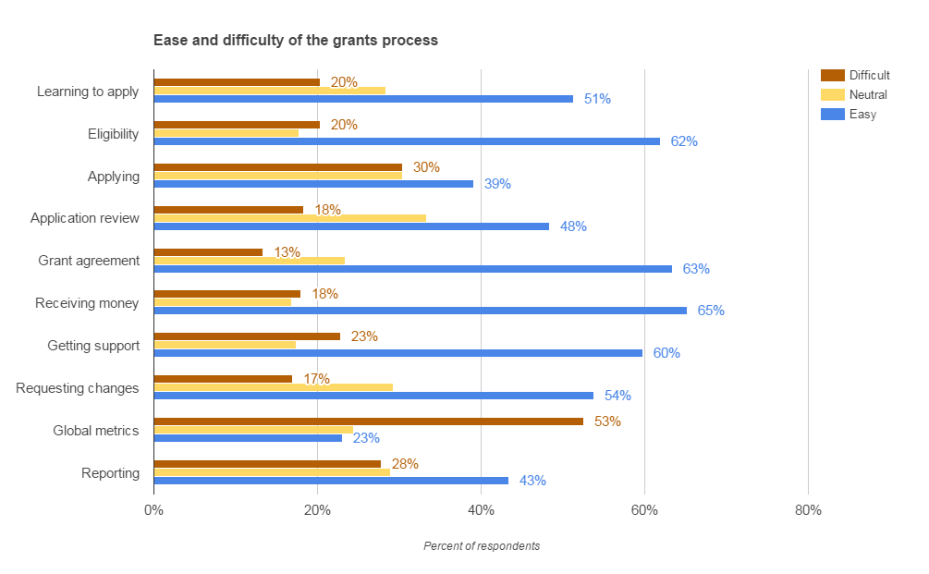
Image source: Wikimedia Commons
Notes:
This slide has too much information and no clear focal point, and therefore no story to tell.

Slide 27
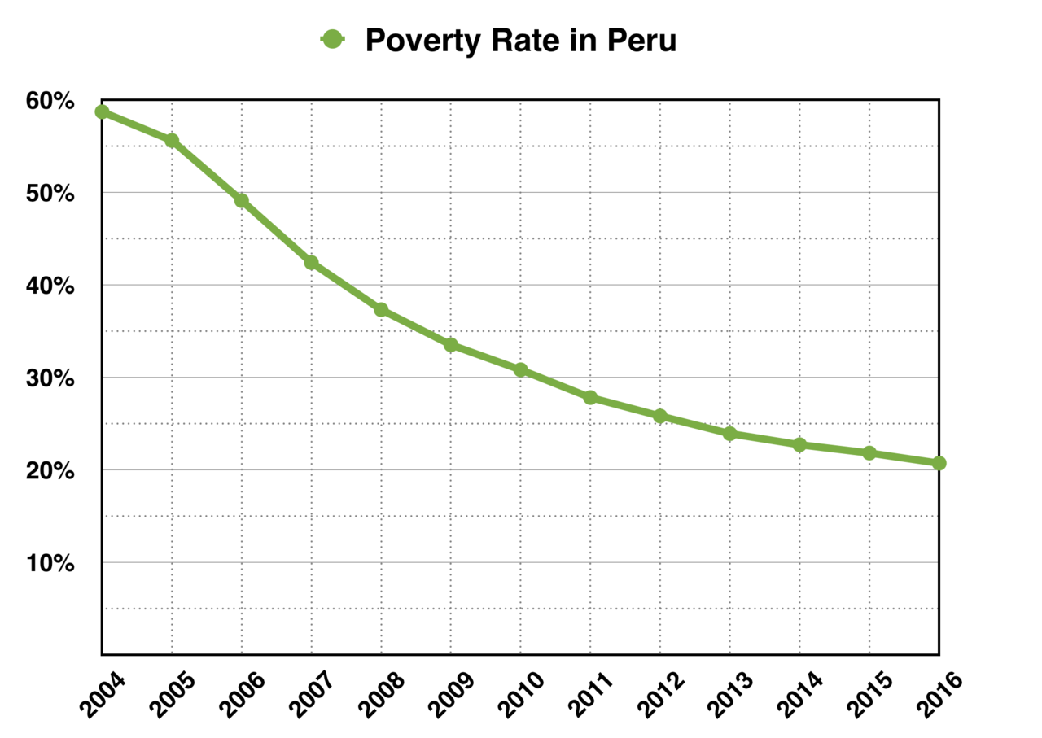
Notes:
This slide has a clear focal point and tells it’s own story of a clear trend. The next part of the story would be to explain why this has been happening!

Slide 28
Making content engaging
According to Cancer Council Australia (2013), one-third of Australians will be diagnosed with cancer at some stage in their lives.
Notes:
You could read this statistic out to your audience and hope they remember it. Or, you could ask each person to look at the person on either side of them, and then tell them that, statistically speaking, one of the three of you is likely to be diagnosed with cancer at some point. This is directly related to each person in the audience, and therefore gives them more reason to care and therefore to remember.

Slide 29
Making content engaging
According to UNICEF (2013), extreme poverty claims the lives of more than 10 million people around the world annually.
Notes:
This is quite a powerful statistic. But how could you make it even more powerful?
One possibility is that you could count out loud to 6, and then say: “While I was counting, 2 people died of extreme poverty somewhere in the world”. This is both more dramatic and more tangible to the audience. 10 million is just a number in the end, but relating it to time that they are experiencing makes it mean more to them.

Slide 30
Images are engaging, but:
- they shouldn’t distract from your message, and
- they must be relevant to your point
2. Images

Slide 31



Images
Image: https://pixabay.com/
Image: https://pixabay.com/
Image: https://www.shutterstock.com/
Good sources of images:
  Pixabay
  Unsplash
  Shutterstock
  Google images (but be careful!)
Notes:
You should always put the source of your image underneath the image, just as you would cite information or ideas from another source that you use in your essay or report.

Slide 32
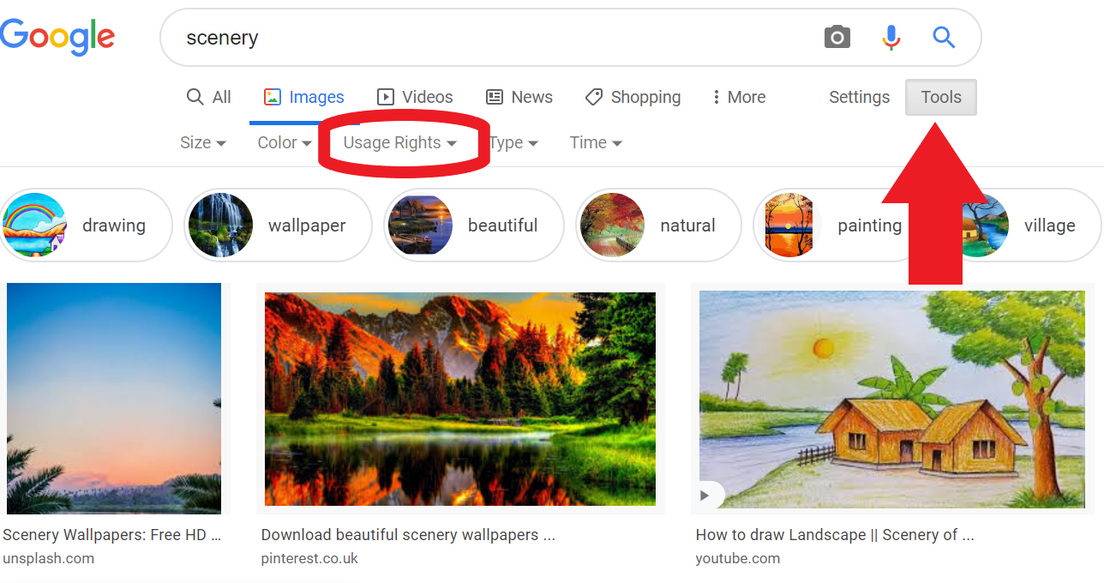
Notes:
When using google images, make sure you are being copyright compliant by Using the ‘Tools’ button to select the Usage rights. You should aim for ‘Labelled for reuse’, unless you want to change the picture (which is unlikely).

Slide 33
3. Headings
Headings should not be full sentences.
Most commonly they are one key word, or a noun phrase.
e.g. Basics of slide design

Slide 34

Benefits of Solar Energy
Solar energy is renewable and therefore better for the environment.
It is relatively cheap to produce
Sunshine is plentiful and widespread.
Image Source: Wikimedia Commons
Notes:
Which heading would be appropriate for this slide?

Slide 35
Don’t be afraid of blank spaces!

Slide 36

4. Text
  Bullet points are best displayed one at a time.
  Text should be at least font size 24 and strongly contrasted with the background.
Notes:
Fonts without serifs (those small embellishments on a letter) and with a high contrast between background and text colour are particularly important for vision-impaired people, or those used to a non-Roman script.

Slide 37
Delivering confidently

Slide 38
Excited
Rapid heartbeat
Shallow breath
Trembling
Talking quickly
Can’t stay still
Nervous
Rapid heartbeat
Shallow breath
Trembling
Talking quickly
Can’t stay still
Notes:
ACTIVITY: Students go into breakout rooms, where one student should open PPT and share screen, and then all students contribute ideas for how to better present this information. The info can be copied and pasted into the chat so all students have access to it in breakout rooms

Slide 39
It’s the most effective way to calm yourself.
It also increases mental clarity and memory.
Try it now: Breathe in for 4, hold for 2, out for 4
1. Breathe!
Notes:
Simple breathing exercises:
Listen to breath whilst listening to me
To themselves
In for 4, hold for 2, out for 4

Slide 40
2. Pause!
It allows you time to take a deep breath.
It gives you time to remember what you want to say next.

Slide 41
3. Eye Contact
Engages audience

Slide 42
3. Smile!
Smiling engages the audience
It gives the impression of confidence
It reduces stress

Slide 43
The Science of Smiling…
Smiling produces endorphins, serotonin and dopamine, which:
lower your heart rate and blood pressure
relax your body
generate more positive emotions
trigger an audience response of smiling back
make others see you as more attractive, reliable and sincere

Slide 44




So…
Smile and the world smiles with you!

Slide 45
In front of a mirror
In front of family or friends
Into the camera of your computer or phone
4. Practice!

Slide 46
Positive body language projects confidence.
It also triggers a feeling of power.
Listeners are more influenced by what you say.
Gorman, C.K. (2017, 2 August). Don’t try to ‘fake’ confidence – do this instead. Forbes Magazine.
5. Check your body language
Notes:
Harvard & Columbia business schools found that standing with a physically expanded body – feet wide, hands on hips – then you feel more powerful & people are more influenced by what you say.
Gorman, C.K. (2017, 2 August). Don’t try to ‘fake’ confidence – do this instead. Forbes Magazine.

Slide 47
ACTIVITY
What do you notice about
the following presenter?
Simon Sinek: Why good leaders make you feel safe

Slide 48
Why does he appear confident?
He stands mostly still, without pacing or fidgeting.
He stands straight and tall.
He maintains eye contact with his audience throughout.
He pauses for dramatic effect when telling stories.
His gestures are firm and emphasise his points.
Notes:
Simon Sinek: Why good leaders make you feel safe: https://www.youtube.com/watch?v=xsvEaU92xeY
Before watching, encourage students as they watch to think about what he does or says that makes them think he is (or is not) a confident speaker.

Slide 49
Summary – A good presentation….
Has a clear purpose
Has a logical structure
Use relevant statistics, stories, examples or images to engage the audience
Is presented with enthusiasm and confidence
Notes:
A good presentation
Has a clear purpose
Has a logical structure
Use relevant statistics, stories, examples or images to engage the audience
Is presented with enthusiasm and confidence

Slide 50

Study Ready – Autumn
Workshops run in Week 1 of the session.
10:00am-1:45pm
Tuesday 29th July
Wednesday 30th July
Sign up via CareerHub (scan!)

Slide 51


Keep up with everything HELPS!
Follow us on Instagram for more study tips and news about HELPS events!
Scan the QR code →

Slide 52
QUESTIONS
???

Slide 53
UTS HELPS
 9514 9733
 helps@uts.edu.au
 www.helps.uts.edu.au
.

