Slide 1
UTS HELPS
How to Avoid Plagiarism

Slide 2
Workshop Objectives
To distinguish the difference between plagiarism and acceptable academic practices.
To examine when and how to quote, paraphrase and summarise.

Slide 3

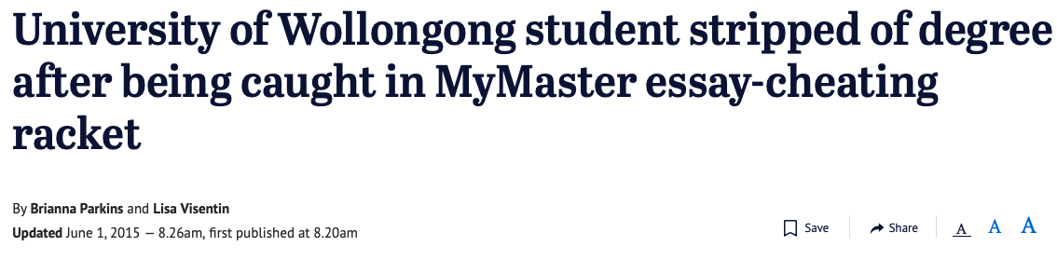
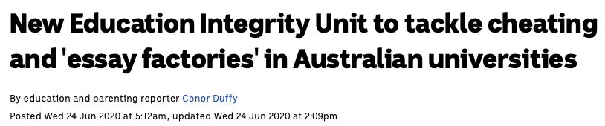
Notes:
You’d rather not be one of the students at the centre of these headlines!

Slide 4

Why do universities take plagiarism so seriously?
DISCUSSION
Image source: https://freesvg.org
Notes:
Work you produce at university often involves the important ideas, writings and discoveries of experts in your field of study.
The work of other writers can provide you with information, evidence and ideas, but must be incorporated into your work carefully and ethically.
Quoting, paraphrasing and summarising are different ways of including the works of others in your assignments. Each of these methods, combined with the correct use of a referencing system, will help you to avoid plagiarism.

Slide 5
The value of your degree is based on employer’s trusting that you have the knowledge and skills that your degree says you should have.
Notes:
➔ involves trust between students, academic staff and examiners
➔ helps to continue the value of an institution’s reputation and the value of a degree or credentials
➔ demands personal integrity and respect for scholarship
➔ requires correct referencing techniques to acknowledge the original source of your information

Slide 6
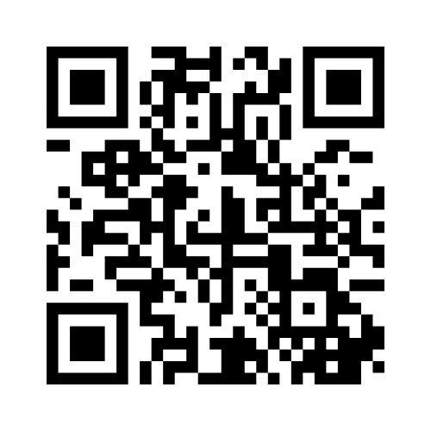
Go to www.menti.com
Enter the code:
54 60 58 2
What is plagiarism?
Image source: https://freesvg.org
Notes:
Work you produce at university often involves the important ideas, writings and discoveries of experts in your field of study.
The work of other writers can provide you with information, evidence and ideas, but must be incorporated into your work carefully and ethically.
Quoting, paraphrasing and summarising are different ways of including the works of others in your assignments. Each of these methods, combined with the correct use of a referencing system, will help you to avoid plagiarism.

Slide 7
What is plagiarism?
Handing in someone else’s work (including AI) as your own (i.e. deliberate cheating).
Using other people’s (including AI’s) words, ideas, images, code etc without properly acknowledging the original source (may be deliberate or accidental).
Notes:
➔ presenting someone else’s work in any format as your own original work without appropriate acknowledgement of the author or its source
➔ can also be deliberate cheating or copying and pasting from sources without correct acknowledgement
➔ is a type of student misconduct and a breach of academic integrity
➔ can result in failing the assessment task, failing the subject and/or being excluded from the university

Slide 8
Go to www.menti.com
Enter the code:
54 60 58 2
Why use other people’s ideas? ?
Image source: https://freesvg.org
Notes:
Work you produce at university often involves the important ideas, writings and discoveries of experts in your field of study.
The work of other writers can provide you with information, evidence and ideas, but must be incorporated into your work carefully and ethically.
Quoting, paraphrasing and summarising are different ways of including the works of others in your assignments. Each of these methods, combined with the correct use of a referencing system, will help you to avoid plagiarism.

Slide 9
Why do we use other people’s ideas?
To summarise concepts or give examples to fully explore a topic
To explain and evaluate the existing research related to your topic
To provide evidence to support your claims or recommendations
Notes:
Work you produce at university often involves the important ideas, writings and discoveries of experts in your field of study.
The work of other writers can provide you with information, evidence and ideas, but must be incorporated into your work carefully and ethically.
Quoting, paraphrasing and summarising are different ways of including the works of others in your assignments. Each of these methods, combined with the correct use of a referencing system, will help you to avoid plagiarism.

Slide 10
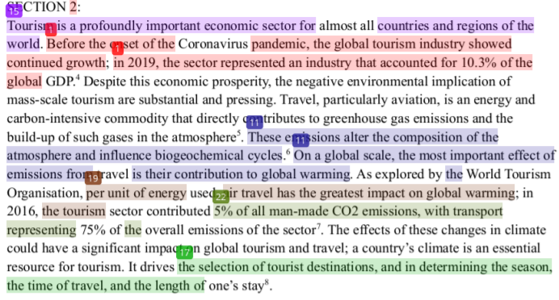
What does plagiarism look like?
Turnitin

Slide 11
What should I do to avoid plagiarism?
Learn when and how to quote, paraphrase and summarise.
Learn how to cite and reference your sources properly.
Give yourself enough time to do your assignments properly.
Notes:
Work you produce at university often involves the important ideas, writings and discoveries of experts in your field of study.
The work of other writers can provide you with information, evidence and ideas, but must be incorporated into your work carefully and ethically.
Quoting, paraphrasing and summarising are different ways of including the works of others in your assignments. Each of these methods, combined with the correct use of a referencing system, will help you to avoid plagiarism.

Slide 12
Which of the following are examples of plagiarism?
Buying an assignment written by someone else on your behalf.
Brainstorming ideas with classmates.
Working with another student on an assignment intended for individual submission, and then submitting work which is similar in content and language.
Asking a trusted classmate to read your assignment to see if it ‘makes sense’.
Notes:
Work you produce at university often involves the important ideas, writings and discoveries of experts in your field of study.
The work of other writers can provide you with information, evidence and ideas, but must be incorporated into your work carefully and ethically.
Quoting, paraphrasing and summarising are different ways of including the works of others in your assignments. Each of these methods, combined with the correct use of a referencing system, will help you to avoid plagiarism.

Slide 13
Which of the following are examples of plagiarism?
Buying an assignment written by someone else on your behalf.
Brainstorming ideas with classmates.
Working with another student on an assignment intended for individual submission, and then submitting work which is similar in content and language.
Asking a trusted classmate to read your assignment to see if it ‘makes sense’.
Notes:
Work you produce at university often involves the important ideas, writings and discoveries of experts in your field of study.
The work of other writers can provide you with information, evidence and ideas, but must be incorporated into your work carefully and ethically.
Quoting, paraphrasing and summarising are different ways of including the works of others in your assignments. Each of these methods, combined with the correct use of a referencing system, will help you to avoid plagiarism.

Slide 14
Quotations
Should only be used occasionally
Always require quotation marks to indicate you’re using someone else’s words exactly
Include the page number in the citation (where relevant)
e.g.
Globalisation is defined as “a process of global interconnectedness through trade, migration and cultural exchange” (Smith, 2019, p. 187).
Notes:
Quotes are used when the author:
expresses the idea in an original way, or
gives a definition of a key term.
They should be introduced or explained.

Slide 15
How to Quote
Quotes are used when the author:
  expresses the idea in an original way, or
  gives a definition of a key term.
They should be introduced or explained.
e.g.
Although Wong (2019, p. 87) describes globalisation as “the biggest contributor to the recent reduction in global poverty rates”, there are many who disagree.
Notes:
Quotes should never be “dumped” into your assignment, or strung together one after the other. They should be used purposefully and sparingly to make a specific point, which you need to help explain to your reader.

Slide 16
ACTIVITY
Which of the following quotes is most appropriate and why?
1. A variable cost can be defined as “one which varies directly with changes in the level of activity over a defined period of time” (Peirson & Ramsay, 2016, p. 693).
2. “Empowerment is a process which allows for ethical decision making by all members of an organisation” (Haskin, 2020, p. 29).
3. Rodrigues argues that “governments around the globe have been too slow to respond to COVID-19”.

Slide 17
ACTIVITY
1. A variable cost can be defined as “one which varies directly with changes in the level of activity over a defined period of time” (Peirson & Ramsay, 2016, p. 693).
2. “Empowerment allows for ethical decision making by all members of an organisation” (Haskin, 2020, p. 29).
3. Rodrigues argues that “governments around the globe have been to slow to respond to COVID-19”.
Notes:
The first one is the best quote because the second one doesn’t give any introduction to or explanation of the quote, and the third one doesn’t include a citation

Slide 18
ACTIVITY
1. A variable cost can be defined as “one which varies directly with changes in the level of activity over a defined period of time” (Peirson & Ramsay, 2016, para. 693).
2. “Empowerment allows for ethical decision making by all members of an organisation” (Haskin, 2020, p. 29).
3. Rodrigues argues that “governments around the globe have been to slow to respond to COVID-19”.
Notes:
The first one is the best quote because the second one doesn’t give any introduction to or explanation of the quote, and the third one doesn’t include a citation

Slide 19
ACTIVITY
1. A variable cost can be defined as “one which varies directly with changes in the level of activity over a defined period of time” (Peirson & Ramsay, 2016, 5:36).
2. “Empowerment allows for ethical decision making by all members of an organisation” (Haskin, 2020, p. 29).
3. Rodrigues argues that “governments around the globe have been to slow to respond to COVID-19”.
Notes:
The first one is the best quote because the second one doesn’t give any introduction to or explanation of the quote, and the third one doesn’t include a citation

Slide 20
Paraphrasing
Is much more common than quoting
Uses your own words to express information from another source
Uses the same citation and referencing style as quoting
Notes:
Paraphrasing
A paraphrase is writing the ideas expressed by another author in an article in your own words without changing the original meaning. It is usually about the same length as the original. The sentence structure and the vocabulary must be different.
Why paraphrase?
Paraphrasing shows the lecturer you have understand the information you’re including from other sources, and also ensures that the whole assignment is written in the same style (i.e. your writing style).
The sources of paraphrased ideas need to be acknowledged in your text, although usually without a page number required, and in a reference list using the appropriate referencing style.

Slide 21
5 Steps to Effective Paraphrasing
  Read the original information several times to be sure you understand it clearly.
  Underline any words that must be kept in order to keep the meaning.
  Write your paraphrase without looking at the original text, trying to change the sentence structure and most of the words.
  Compare your version with the original to see if you have captured the meaning of the writer as closely as you can, while significantly changing the words.
  Add the citation and reference list entry.

Slide 22
Paraphrasing Example
The United States, Germany, Japan and other industrial powers are being transformed from industrial economies to knowledge and information based service economies, whilst manufacturing has been moving to low wage countries.
(Source: Laudon & Laudon 2002, Management information systems: managing the digital firm, Prentice Hall, New Jersey.)
Notes:
This activity could be done using Jamboard (a free Google product)

Slide 23
Paraphrasing Example
The United States, Germany, Japan and other industrial powers are being transformed from industrial economies to knowledge and information based service economies, whilst manufacturing has been moving to low wage countries.
(Source: Laudon & Laudon 2002, Management information systems: managing the digital firm, Prentice Hall, New Jersey.)
Notes:
This activity could be done using Jamboard (a free Google product)

Slide 24
Activity
Which of these two paraphrases is the most appropriate?
Paraphrase 1
The United States, Germany, Japan and other economies are being dramatically changed from industrial economies to knowledge and information based service economies as manufacturing shifts to countries where the wages are low cost (Laudon & Laudon, 2002).
Paraphrase 2
As manufacturing has moved to countries where labour is cheaper, former industrial economies such as the United States, Japan and Germany have based their economies on service industries in which information is more valuable than labour (Laudon & Laudon, 2002).

Slide 25
Paraphrase 1 is acceptable because it closely follows the sentence structure of the original.
Both paraphrases are acceptable because some of the keywords have been changed.
Paraphrase 2 is acceptable because the sentence structure has been changed significantly but the meaning is the same.
Paraphrase 2 is not acceptable because the sentence structure has been changed.

Slide 26
Paraphrase 1 is acceptable because it closely follows the sentence structure of the original.
Both paraphrases are acceptable because some of the keywords have been changed.
Paraphrase 2 is acceptable because the sentence structure has been changed significantly but the meaning is the same.
Paraphrase 2 is not acceptable because the sentence structure has been changed.

Slide 27
Summarising
Provides a brief description of a long text
Can be useful for giving a brief overview of:
  an author’s main argument
  the findings of a research study
  a case study
Notes:
Generally used when you wish to refer to ideas contained in a long text. Summarising enables you to reduce the author's ideas to key points in an outline of the discussion or argument by omitting unnecessary details and examples.
Summarising a single source or a collection of related sources can provide your reader with background or supporting information that helps them better understand your chosen topic. It is also a useful method to point out material that either supports or contradicts your argument while not distracting your reader with irrelevant details.
As with quoting and paraphrasing, you must document the sources you summarise. A summary reduces the material into a more concise statement. To be effective, you must choose your words carefully, be accurate, objective, focused and concise.

Slide 28
Summarising Tips
Only the main points need to be included
The words should be mostly your own
An in-text citation and reference list entry is required
e.g.
Wiley and Bligh (2021) surveyed 2000 university students and found that nearly half of them had considered dropping out of their studies while studying online during COVID.

Slide 29
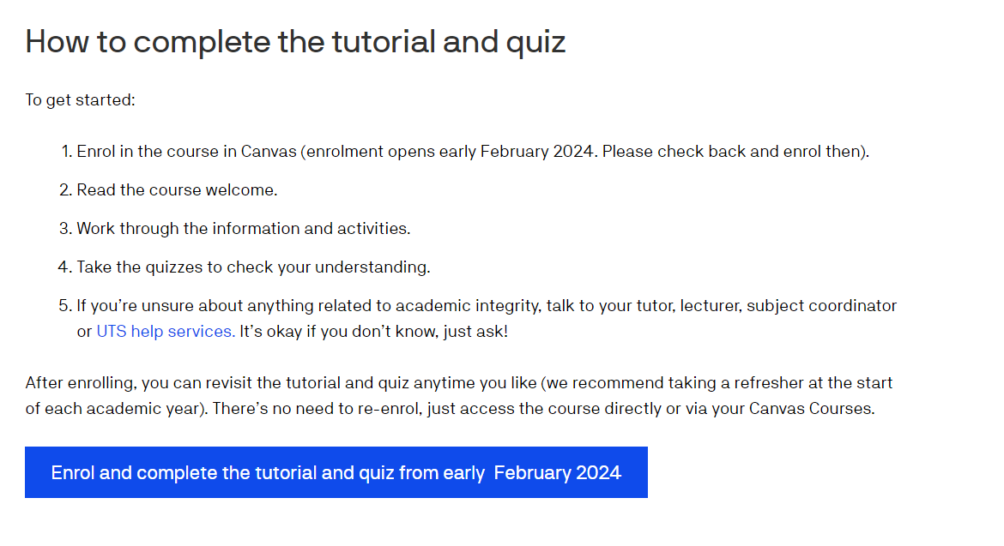
Avoiding Plagiarism Quiz
Notes:
Click on the image to go to the ‘Avoiding Plagiarism’ quiz.
You can either do the quiz as a whole class, encouraging students to enter their responses to each question in the chat before showing the answers or get students to log into the quiz themselves and do it in small groups in breakout rooms.

Slide 30
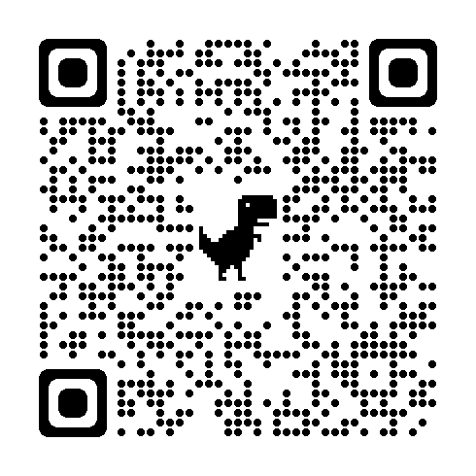
Academic Integrity Tutorial & Quiz (Canvas)
Notes:
https://www.uts.edu.au/current-students/support/academic-support/academic-integrity/tutorial-and-quiz

Slide 31
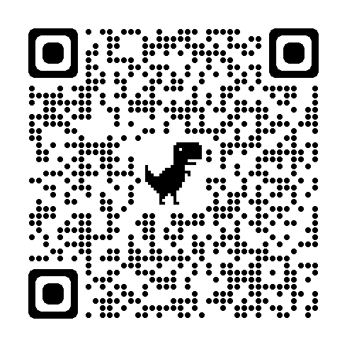
Tips on using Generative AI (Gen AI)
Notes:
https://www.uts.edu.au/current-students/support/helps/self-help-resources/genai-learning-resources

Slide 32
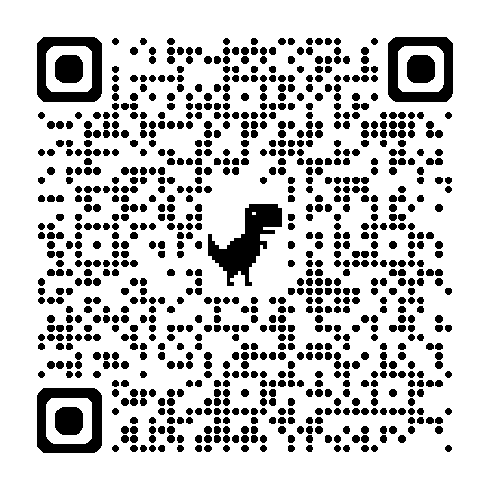
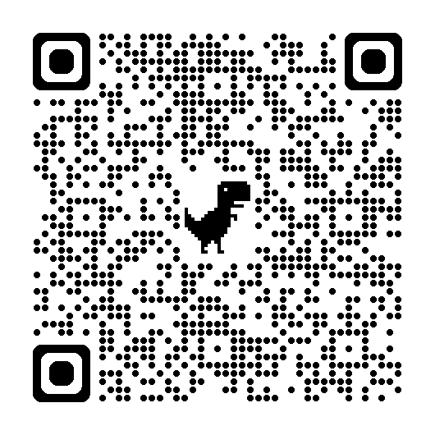
More information
Online self-help learning resources
  How to Avoid Plagiarism
  How to Paraphrase Effectively
Individual consultations
 helps.uts.edu.au

Slide 33
Thank you

Slide 34

Study Ready – Autumn
Workshops run in Week 1 of the session.
10:00am-1:45pm
Tuesday 29th July
Wednesday 30th July
Sign up via CareerHub (scan!)

Slide 35

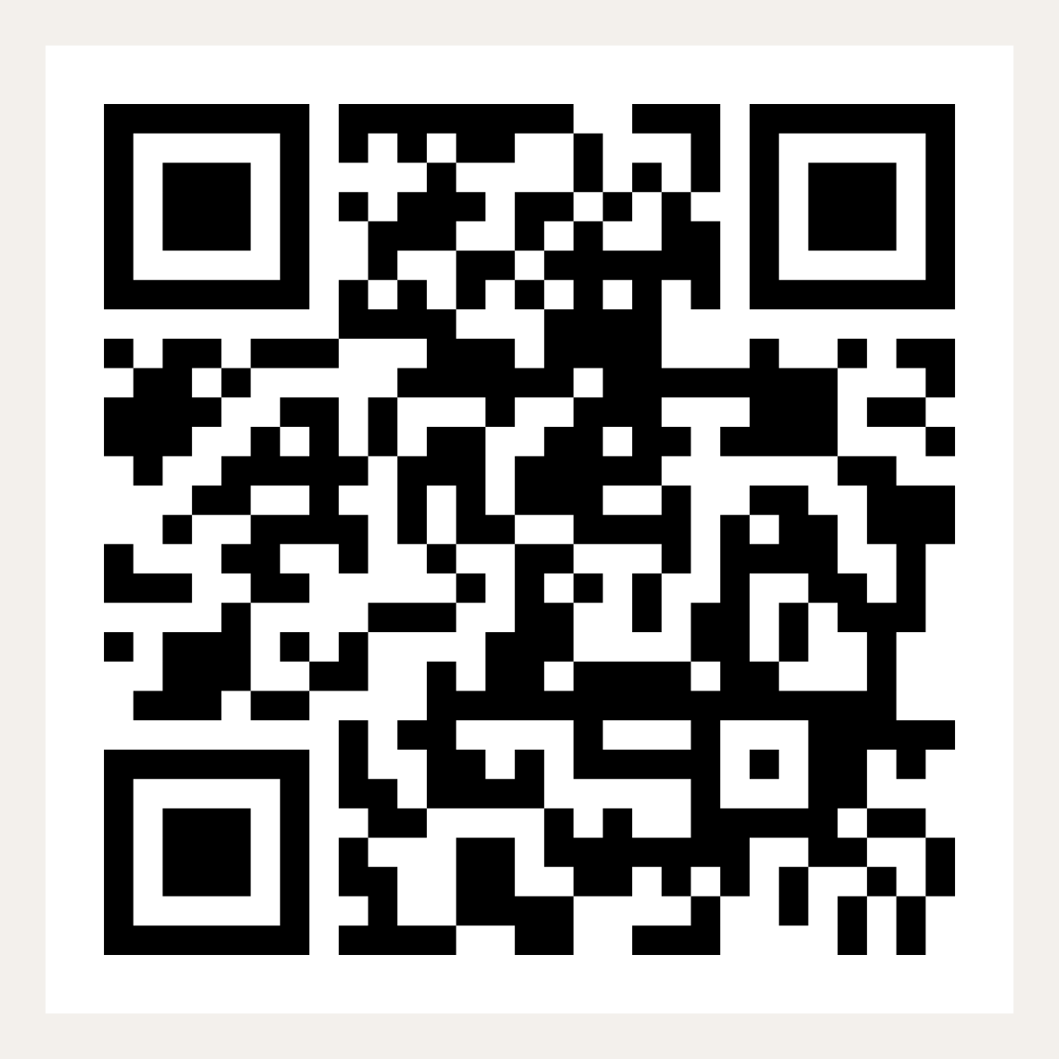
Keep up with everything HELPS!
Follow us on Instagram for more study tips and news about HELPS events!
Scan the QR code →

Slide 36
UTS HELPS
 9514 9733
 helps@uts.edu.au
 www.helps.uts.edu.au
.

