Slide 1
Building a level playing field for distributed energy with local network credits and virtual net meterinG
Jay Rutovitz, Institute for Sustainale Futures
All Energy Conference 2015, Melbourne, October 7th 2015

Slide 2
Session Overview
Jay Rutovitz, Institute for Sustainable Futures Context Valuing local energy: the concepts The project (Facilitating local network charges and VNM)
Mark Byrne, Total Environment Centre The Rule Change proposal
Lara Olsen, Powercor A Network Service Provider perspective
Miguel Brandao, AGL A retailer perspective

Slide 3
Context

Slide 4
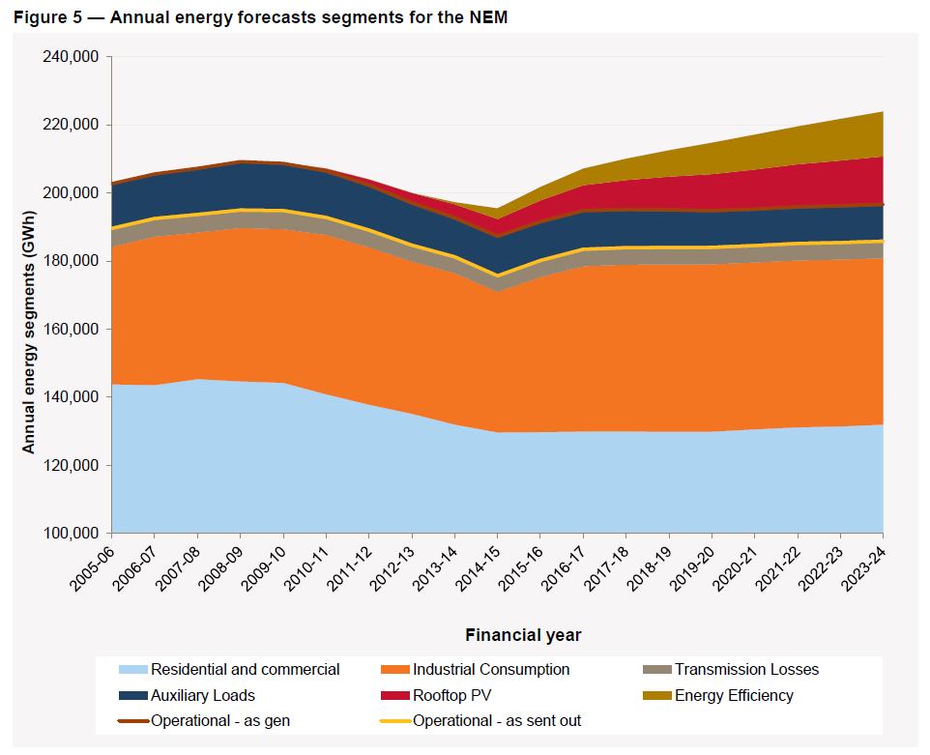
HISTORIC POINT OF TRANSFORMATION
Centralised electricity supply falling, already peaked?
Energy efficiency
Rooftop solar PV
Behaviour change (price effect)
ANNUAL ENERGY FORECAST FOR THE NEM (June 2014 NEFR)

Slide 5
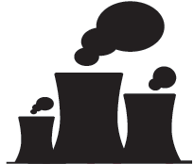
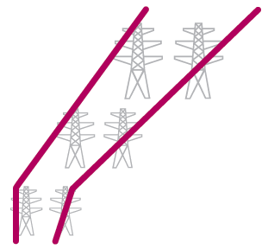





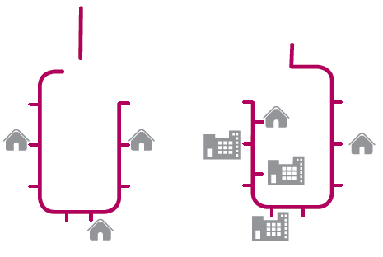




Today:
Highly centralised network

Slide 6


















The future: decentralised network

Slide 7
…WITh far more
LOCAL ENERGY
Local
Energy

Slide 8
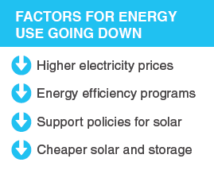
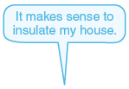
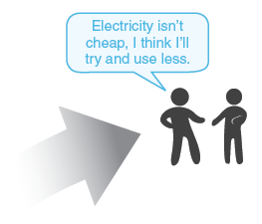



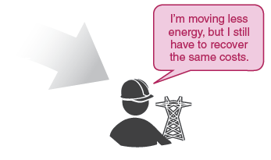


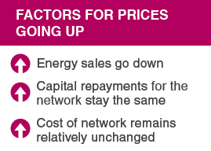



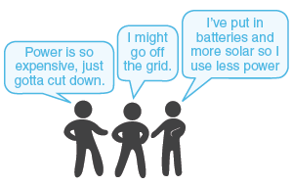


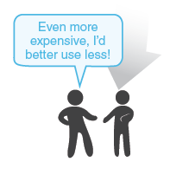
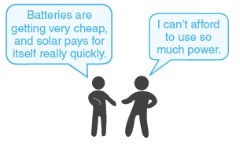








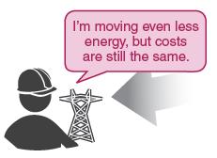

Possible outcome - the death spiral
Notes:
Key drivers for consumption falling:
Price
Solar PV
EE and RE policies
Key drivers for prices
Energy sales down
Captial repayment stay the same
Cost of network relatively unchanged

Slide 9
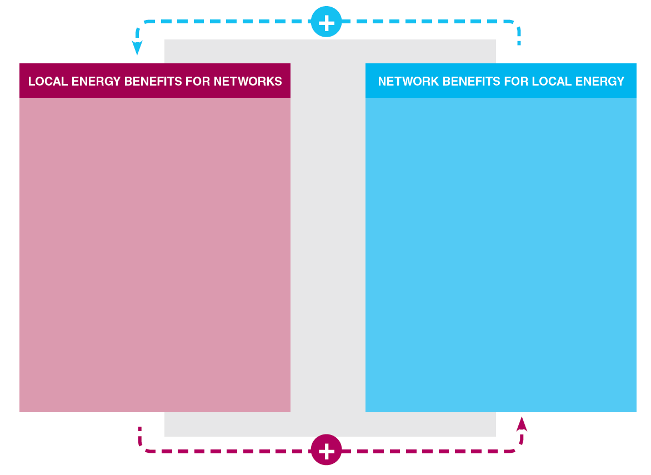
Possible outcome : MUTUAL BENEFITS
Reduced transmission and distribution losses
Potential to save money on network investment
Emissions reduction
Increased resilience of system
Technical network services
Provides local generators access to bigger markets
Keeps high level of reliability
Allows local generator to run system for maximum efficiency
Supports technical requirements of consumers

Slide 10
VALUING LOCAL energy :
Local network charges and local electricity trading

Slide 11
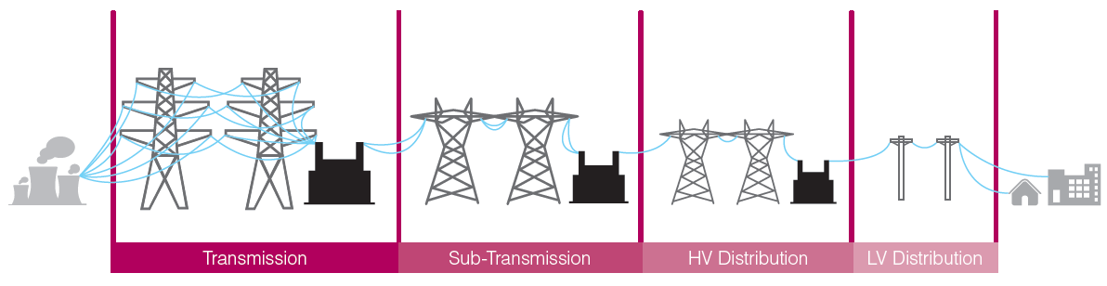
Network Charges - What happens now
Local Energy
Current network charges for local energy

Slide 12
The problem
DGs sell at wholesale and buy back at retail prices, including full network charges
Strong incentive for customers (and product developers) to focus “behind the meter” & reduce grid consumption
Perverse incentive to duplicate infrastructure
Sub optimal sizing of generators and little incentive to supply grid services
Increases costs for consumers left using only grid electricity, as infrastructure costs are recouped from smaller sales volume
Notes:
1 Already happening (e.g. Willoughby Council)
2 Constrains potential cost effective DG
3 Reduced network revenue > Defensive pricing strategies

Slide 13
The concepts
TYPICAL MAKEUP OF ELECTRICITY BILL
Local network charges: reduced tariffs for electricity generation used within a defined local network area
$ network charges
affects this part
Local Electricity Trading”** requires netting off generation from one site at another site on a time-of-use basis, so that Site 1 can ‘sell’ or assign generation to nearby Site 2
** also known as VNM
$ retail
affects this part
$ energy costs
Notes:
BARRIERS
In theory no regulatory reason to stop NSPs offering local network charges and retailers offering VNM
…BUT no requirement, and no methodology
Retailers may offer VNM on case by case basis, but costly to do that way
Rule change required to introduce Local Network Charges, and may be required for VNM

Slide 14
The project: FACILITATING Local network charges AND LOCAL ELECTRICITY TRADING**
** Virtual Net Metering (VNM)

Slide 15
The project
Objective: To facilitate the introduction of local network charges & Local Electricity Trading**
Five case studies, or “virtual trials”
A recommended methodology for calculating local network charges
An assessment of technical requirements and indicative costs for Local Electricity Trading
Economic modelling of benefits & impacts
Increase stakeholder understanding and support for rule change(s)
** also called Virtual Net Metering or VNM

Slide 16











PARTNERS: A BROAD COALITION
PROJECT
LEAD
MAIN
SPONSOR
Networks NSW
Energy Australia
Electricity Retailers Association
Electricity Networks Association
Clean Energy Council
Coalition for Community Energy
CITY OF
SYDNEY

Slide 17




virtual
FRINGE OF GRID
Tech | Bioenergy (TBC)
Network | Ergon Energy
Retailer | Ergon Energy
Model | One →Several
THE TRIALS
^
BYRON
Tech | PV
Network | Essential
Retailer
Model | Council 1 → 1
MOIRA/SWAN HILL
Tech | PV
Network | Powercor
Retailer | AGL
Model | 1 → Many OR Many → 1
WILLOUGHBY
Tech | Cogen
Network | Ausgrid
Retailer | Energy Australia
Model | Council 1 → 1
WANNON WATER
Tech | Wind
Network | Powercor
Retailer | AGL
Model | 1 → 1 OR 1 → 2

Slide 18
Stay in touch – project website & sign up for newsletter
or email: jay.rutovitz@uts.edu.au
http://bit.do/Local-Energy

