Slide 1
Examining New Business Models With Local Network Charges and Virtual Net Metering
Ed Langham, Research Principal
15th September 2015

Slide 2
Overview
CONTEXT: A TRANSFORMING MARKET
LOCAL ENERGY: WHAT IS IT AND WHY ACT?
VALUING LOCAL ENERGY:
Local Network Charges
Virtual Net Metering (VNM)
OPPORTUNITIES & BARRIERS
THE PROJECT…

Slide 3
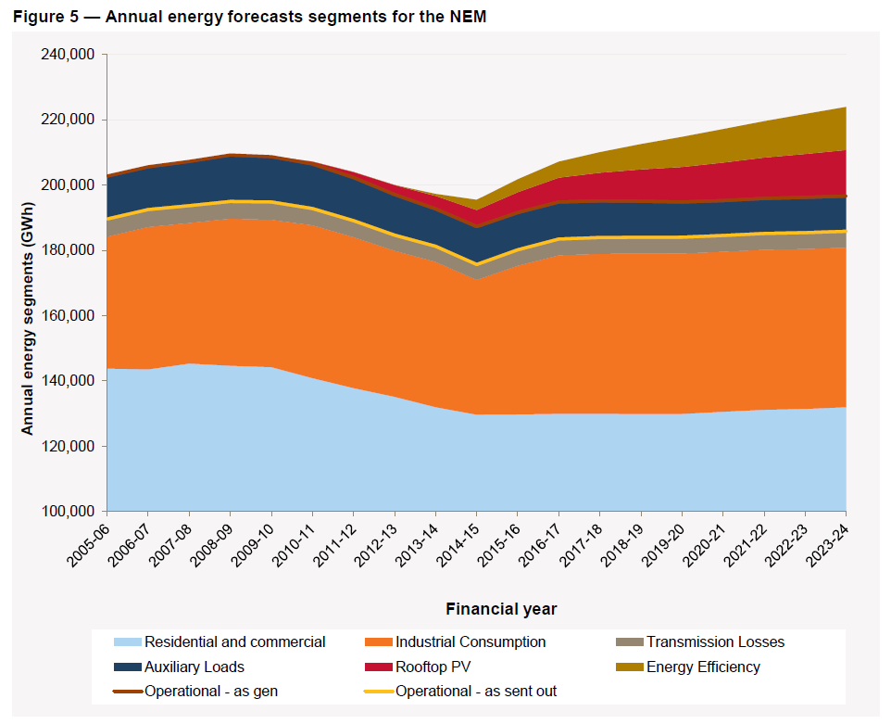
CONTEXT: A TRANSFORMING MARKET
Model of one way flows changing
Renewable energy & energy efficiency support policies
Falling cost of distributed energy
Rising electricity prices
Have we seen “peak grid energy”?
Notes:
Historic transition
Growth assumed for last 25 years, NSPs charged with building to keep pace
Need to act on Climate change has driven policies on EE and RE which have brought about a very different situation
Cost of distributed energy, especially solar PV, dropped dramatically (approx 75%) over last 10 yrs
Different type of consumer

Slide 4
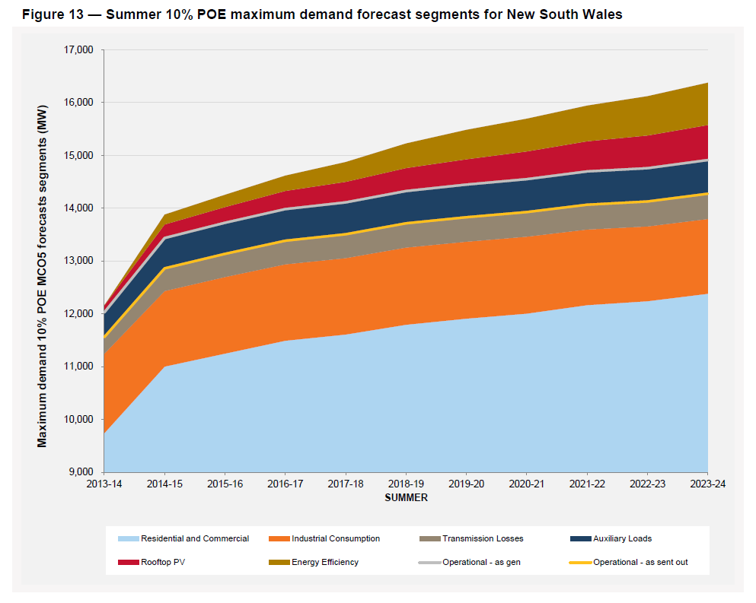
Source: 2014 National Electricity Forecasting Report (NEFR) (June 2014)

Slide 5
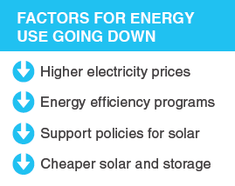
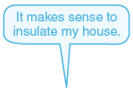
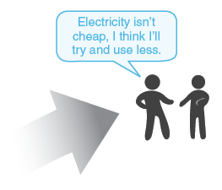
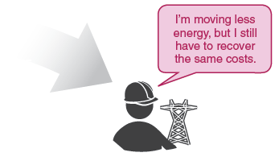
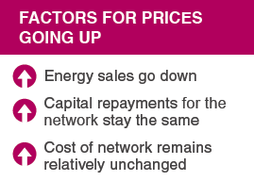
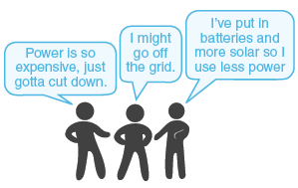
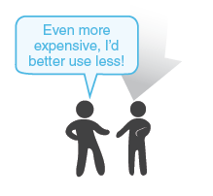
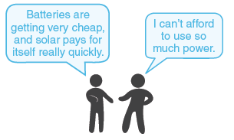
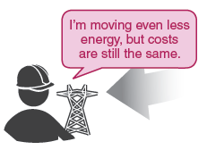
THE SPIRAL
Notes:
Key drivers for consumption falling:
Price
Solar PV
EE and RE policies
Key drivers for prices
Energy sales down
Captial repayment stay the same
Cost of network relatively unchanged

Slide 6
How could network businesses respond to distributed generation & storage?
(possible options)
Defensive:
Technical/Administrative barriers (no more DG connections)
“Defensive” pricing (e.g. raise fixed access charges)
Proactive:
Happening?
Option | Cross-subsidy addressed
Cost reflective pricing | time-of-use
Demand management incentives | spatial/temporal constraints
Local network charges | Partial (local) use of system (level of connection)
✔
✔
✖

Slide 7
NETWORK LEVELS and TERMInology
Local Energy
Local energy: embedded, distributed, or decentralised generation and storage, which means located within the distribution network

Slide 8
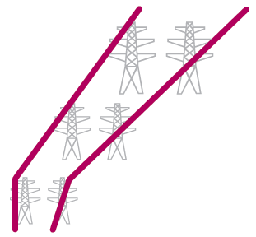
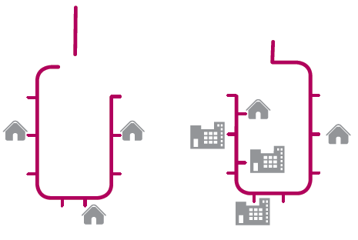
Today: Highly centralised network

Slide 9
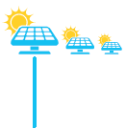
The future: decentralised network

Slide 10
…With far more LOCAL ENERGY
Local
Energy

Slide 11
What happens now
Local Energy
Current network charges for local energy

Slide 12
ALLOCATION OF COSTS BY NETWORK LEVELS
Non-System
System-fixed
Transmission
LV Distribution
Sub- transmission
line
HV Distribution

Slide 13
ALLOCATION OF COSTS BY NETWORK LEVELS
19%
8%
43%
20%
4%
6%
System-fixed
Non-System

Slide 14
COMMON RESULTING PROBLEMS
Perverse incentive to duplicate infrastructure (build embedded networks)
Already happening (e.g. Willoughby Council)
Distributed generators receive only wholesale price for exports
Constrains potential cost effective DG
Strong incentive for customers/product developers to reduce “behind the meter” consumption
Reduced network revenue > Defensive pricing strategies

Slide 15
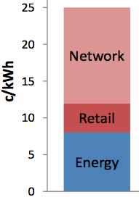
HOW CAN WE VALUE LOCAL ENERGY?
Local Network Charges
Lower network tariffs for energy generated and consumed ‘locally’ (i.e. for partial use of the grid)
Virtual Net Metering (VNM)
The ability to offset energy consumption at one site with metered generation at a second site on a time-of-use basis. Links well with Local Network Charges.

Slide 16
opportunities
Unlock new local energy projects
Reduce load defection for network businesses
Unlock new product offerings e.g. neighbourhood storage
Retailers offering VNM may get competitive advantage
With customer segments (e.g. local govt, large corporates, community energy)
New product offerings

Slide 17
Barriers
Theoretically no regulatory reason why network businesses could not apply local network charges now.
…BUT no methodology or guidance exists on how to do this.
Likely to require Rule Change to require DNSPs to calculate and offer Local Network Charges if to become widely utilised/available.
Retailers can offer VNM now, and currently expect it unlikely that a rule change will be required to enable this.

Slide 18
The Project…
Entitled “Facilitating local network charges and VNM”
Led by ISF
Funded by ARENA and other co-contributors
Runs for 14 months from July 2015

Slide 19
Organisations involved
Local Energy Proponents
Moira Shire Council
Swan Hill Council
Byron Shire Council
Willoughby Council
Wannon Water
City of Sydney
Network Businesses
Ergon Energy
Powercor
Ausgrid / Essential Energy
Retailers
AGL
Energy Australia
Associations/ other
Total Environment Centre
NSW Govt RE Advocate
Electricity Retailers Association
Electricity Networks Association
Clean Energy Council
Property Council of NSW
Alternative Technology Association

Slide 20
PROJECT Objective & KEY DELIVERABLES
Objective: to facilitate local network charges & virtual net metering
Five case studies, or “virtual trials”, of LNC and VNM
A recommended methodology for calculating LNCs
An assessment of the technical requirements and indicative costs for the introduction of Virtual Net Metering
Economic modelling of the benefits & impacts of LNCs and VNM
Increased industry understanding of LNCs and Virtual Net Metering
Specific consultation and support for rule change proposal(s)

Slide 21
virtual
FRINGE OF GRID
Tech | Bioenergy (TBC)
Network | Ergon
Retailer | Ergon
Model | TBC
THE TRIALS
^
BYRON
Tech | PV
Network | Essential
Retailer | Energy Australia
Model | Council 1 → 1
MOIRA/SWAN HILL
Tech | PV
Network | Powercor
Retailer | AGL
Model | 1 → Many OR Many → 1
WILLOUGHBY
Tech | Cogen
Network | Ausgrid
Retailer | Energy Australia
Model | Council 1 → 1
WANNON WATER
Tech | Wind
Network | Powercor
Retailer | AGL
Model | 1 → 1 OR 1 → 2

Slide 22
Thank you
Contact me to keep up with project developments and participate in consultation
Ed Langham
Research Principal
Edward.Langham@uts.edu.au
(02) 9514 4971

Slide 23
HOW TO VALUE LOCAL ENERGY
Paid for all distributed generation
LOCAL NETWORK CHARGES
(or credits)
local generation credit
local generation credit/ or virtual private wire
Links the generator to a customer
LOCAL ENERGY SALES
Virtual Net Metering (or virtual private wire)
WHAT WOULD THESE LOOK LIKE?

Slide 24
PHYSICAL ELECTRICITY FLOWS
Uses 150 MWh
Uses 100 MWh
Generates 110 MWh
Imports 100 MWh
Imports 50 MWh
Exports 10 MWh

Slide 25
MONETARY FLOWS
Uses 150 MWh
Uses 100 MWh
Imports 50 MWh
Imports 100 MWh
Generates 110 MWh
Exports 10 MWh

Slide 26
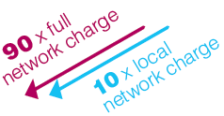
MONETARY FLOWS
Uses 150 MWh
Uses 100 MWh
Imports 50 MWh
Imports 100 MWh
Generates 110 MWh
Exports 10 MWh

