Slide 1
Developing a culture of engagement and Partnership
Eve Lewis
Director
Student Engagement in University decision making – towards a more systemically inclusive student voice

Slide 2
Who are we?
student partnerships in quality Scotland
Full-time staff in Edinburgh and Inverness
Works with all institutions and students’ associations in the university and college sector. Provides international consultancy.
Scottish Charity - members all sector agencies
Main Funding – Scottish Funding Council
www.sparqs.ac.uk

Slide 3
Our Vision is of:
Students making a positive and rewarding difference to their own and others’ educational experience, helping shape the nature of learning and contributing to the overall success of Scotland’s universities and colleges.

Slide 4
To make this Vision a reality our Mission is to
Ensure students are able to engage as partners in all levels of assurance and enhancement activities including:
Commenting on and shaping their own learning experience.
Taking an active part in formal student engagement mechanisms, including quality processes and strategic decision making.
Shaping the development of the student experience at national level.

Slide 5
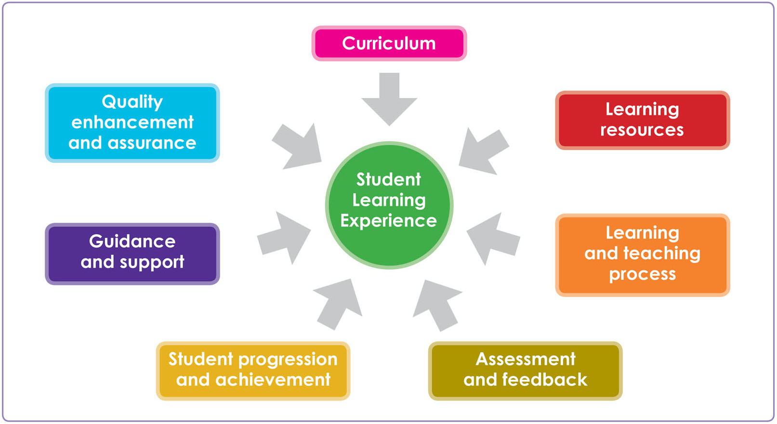
The Student Learning Experience

Slide 6
A Ladder of Citizen Participation - Sherry R Arnstein

Slide 7
Student Engagement - not a new thing
1986 – NUS produced first class rep training pack.
1990’s – professionalisation of student academic representative function.
1994 – Education Act including SU legislation
1996 – 30 SU staff supporting educational representation.
Mid 1990’s – enterprise in Higher Education project led to more staff development and further focus on training.
2002 – Quality Enhancement Framework – student engagement a key pillar.
2003 – sparqs.

Slide 8
1990’s

Slide 9
Scottish Quality Enhancement Framework
Enhancement Led Institutional review.
Institutional Led Subject review.
Student Engagement.
Enhancement themes.
Public Information.
Underpinned by QAA Quality Code(including subject benchmarks)and
external examiners plus external quality measures,
e.g. professional accreditation.

Slide 10
‘The university and the SRC might want to reflect upon how they could most effectively work together to help sustain a partnership that actively contributes to the development of a policy for the enhancement of student learning’
-University of Glasgow ELIR 2004

Slide 11
‘Partnership has delivered significant development in policies and provision, all of which contribute positively to the student learning experience’
Glasgow University ELIR 2010

Slide 12
Student Engagement Framework
Focus on enhancement and change
Valuing the student contribution
Appropriate resources and support
A culture of engagement
Students as partners
Responding to diversity

Slide 13
Development of the Student Engagement Framework
Agreement on need, use and focus of a framework
46 focus groups – wide range of participants
Initial draft
Extensive period of consultation
A jointly owned framework

Slide 14
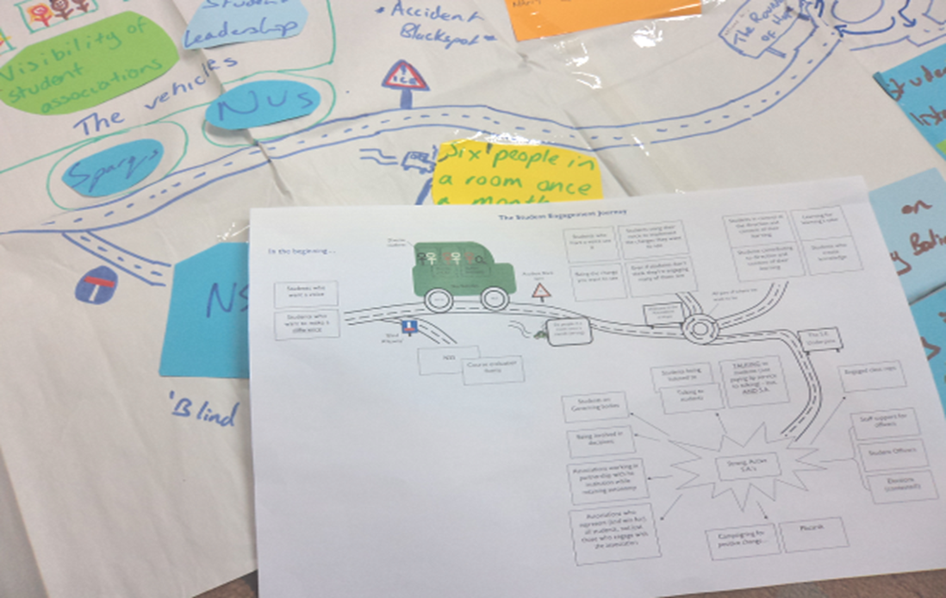

Slide 15
Use of the Student Engagement Framework
Training and resources
Events and publications
Institutional strategic planning
National agencies reference point
National strategic developments – college students associations
Internal sparqs planning

Slide 16
GCU partners the students association to articulate a co-constructed approach to student engagement that reflects key messages of the Student Engagement Framework and QQAUK Quality Code. This joint approach informs the GCU annual student led Student Experience Summit and underpins a sustainable approach to student engagement within existing academic and professional spheres, making student engagement normal practice and ‘just part of what we do’
Professor Nicola Andrew – academic lead - enhancement Glasgow Caledonian University

Slide 17
Celebration report-2013 Element 3
A strategic, partnership –led approach to improving representative systems
Training and support for course reps(4,500 training 13/14)
Course rep/student learning and teaching events
Joined up rep systems(Departmental/faculty reps)
Gathering and responding to student feedback
Responding to Diversity
Student-Led Teaching awards

Slide 18
Element 4.
Learning from ELIR consistently cites Student engagement as a key strength across the sector
Student involvement in formal review processes
‘By 2005 ten institutions had internal student reviewers, now this practice has been universally adopted
Student involvement in major organisation change
Student ownership of reflective analysis
Advocates of student engagement at senior level

Slide 19
Heriot-Watt University
4th amongst universities in the UK for overall student satisfaction in the National Student Survey in 2012; up from 29th position in the previous year.
Top in the UK for Student Experience in the Sunday Times University Guide,
Scottish University of the Year for the second year running.

Slide 20
“Both the University and the Students’ Union believe this success was built on the strong working partnership we have developed over the past few years.”
Professor John Sawkins,
Deputy Principal (Learning and Teaching)

Slide 21
Heriot Watt – how we did it
Developed a systematic approach to collecting and responding to student feedback
Improved course representation structures, training and support, including a well-developed and resourced school officer system
Developed partnership working with students throughout the formal decision making structures including the strategic University Learning and Teaching Board and the Student Learning Experience Committee.

Slide 22
Australian Higher Education threshold standards 2015
‘The governing body takes steps to create an organisational culture where … informed decision making by students is supported and students have opportunities to participate in the deliberative and decision making processes of the higher education provider’

