Slide 1
Student Engagement in Learning and Teaching Quality Management
Prof Gwen van der Velden

Slide 2
Outcomes of a QAA funded research project 2013
Co-authors: Prof Geoff Whitty, Prof Rajani Naidoo, Dr Paolo Piementel-Botas, Alex Pool (now Rhys).

Slide 3
Context (UK)
Effective student representation by well supported Students’ Unions is common
Student Satisfaction survey has been in place 10+ years and steers interest
Sector policy (QAA) expects student engagement in quality management
(Code of practice B5)

Slide 4
Research methodology
Desk based research and online surveys of UK Higher Education Institutions (HEIs), including large, small, specialist and private institutions, and their students’ unions.
Online survey was sent to institutional staff responsible for quality management in 260 institutions and representation officers and sabbatical officers in 199 students’ unions.
Seventy-five institutions and 26 students’ unions responded and completed surveys.
Telephone interviews of a selected group of institutional staff with oversight of quality management in their institution.
Research undertaken during April, May and July 2013.

Slide 5
General findings
Student representation is well informed, well organised and developing
Student involvement in governance is ubiquitous
Quality management relies on student engagement(surveys, reviews, governance and SSLC)

Slide 6
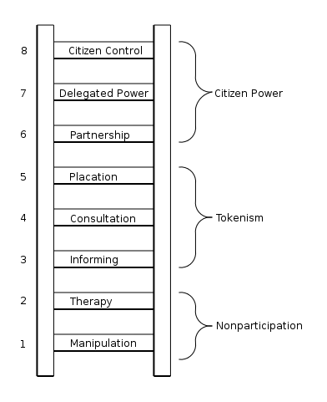
Arnstein, Sherry R. "A Ladder of Citizen Participation," JAIP, Vol. 35, No. 4, July 1969, pp. 216-224.

Slide 7
Conclusions 1
The changing relationship between students and institutions
Institutions mostly described students as ‘stakeholders’ despite the debate in the sector suggesting institutions view students as partners. A third felt students were (also) consumers.
In an effort to keep consumerism at least out of the classroom, institutions appeared to have embraced the partnership ethos as an ideal to strive for at discipline and programme level.

Slide 8
Conclusions 2
Alternative methods of representation and engagement
Rather than using elected or even selected representational forms supported by a students’ union or similar, private institutions* included in our survey, veered towards the appointment and employment of recent graduates to take on representative roles within the organisation.
* Private institutions in the UK do not have a legal requirement to have a Students’ Union

Slide 9
Conclusions 3
The role of students’ unions in institutions is changing
Students’ unions are by and large ‘partners’ to the institution
Institutions recognised that students’ unions collected data independently to inform and sometimes steer developments within the institution.
Institutions are increasingly viewing it as part of their students’ union’s responsibility to find ways of representing hard-to-reach groups effectively.

Slide 10
Conclusions 4
The impact of student voice and engagement
The research supported the commonly made assumption that a strong student voice informs in learning and teaching practices and policies
The single theme of assessment and feedback was mentioned by almost every institution and students’ union as a key area of shared interest (but..)
Student engagement led considerably more often to enhancement of transactional rather than transformational aspects

Slide 11
Conclusions 5
The influence of the student voice is broadening.
The student voice now influences professional services, expressing student interests beyond the student learning experience and in a few cases, overall institutional strategic planning.
This pervasive involvement of students was interpreted as a sign of a genuine change in ethos in those institutions.

Slide 12
Conclusions 6
Student charters or similar ‘partnership’ agreements are widely implemented but have yet to find their relevance to student engagement
Both institutions and students’ unions also expressed concerns about the relevance of a charter in students’ and staff’s day to day practice and whether charters covered all student groups equally and effectively.
Both institutions and students’ unions saw advantages in the process of drafting such statements.

Slide 13
References
Cockburn, D. (2005) Report of the higher education mapping exercise of student involvement in quality assurance and enhancement processes. Edinburgh: Student Participation in Quality Scotland. Available: http://www.sparqs.ac.uk/upfiles/Celebration%20Uni%20Summary.pdf
HEFCE (2003). Collecting and using student feedback on quality and standards of learning and teaching in Higher Education. HEFCE, Bristol, UK. Available: http://oro.open.ac.uk/11876/4/
Little, B., Locke, W., Scesa, A. and Williams, R. (2009). Report to HEFCE on student engagement. London: Centre For Higher Education Research and Information (CHERI). Available: http://www.open.ac.uk/cheri/documents/student-engagement-report.pdf
NUS (2012) A Manifesto for Partnership, NUS London. http://www.nusconnect.org.uk/campaigns/highereducation/partnership/a-manifesto-for-partnerships/
Quality Assurance Agency for Higher Education (2012c) UK Quality Code for Higher Education, Part B: Ensuring and Enhancing Academic Quality, Chapter B5 Student Engagement, Gloucester: QAA http://www.qaa.ac.uk/Publications/InformationAndGuidance/Documents/Quality-Code-Chapter-B5.pdf
Van der Velden, G. M. (2012a). Institutional level student engagement and organisational cultures. Higher Education Quarterly, 66(3): 227-247.
Van der Velden, G.M (2012b). Student Engagement: Whose education is it anyway? Talking about Quality. Available: http://www.qaa.ac.uk/Publications/InformationAndGuidance/Documents/talking-about-quality-student-engagement.pdf

