Slide 1
Student Engagement: The Irish Experience
UTS Sydney Sept 2017
#NStEPRollOut @NStEPie

Slide 2
Useful links
NStEP Partners:
Higher Education Authority @hea_irl www.hea.ie
Quality & Qualifications Ireland @qqi_connect www.qqi.ie
Union of Students in Ireland @TheUSI www.usi.ie
Irish Principles of Student Engagement Summary: http://www.hea.ie/sites/default/files/principles_student_engagement_insert_final_web_version_0.pdf
Irish Principles full doc: http://www.hea.ie/sites/default/files/enhancing_student_engagement_in_decision_making_1.pdf
sparqs – student partnerships in quality Scotland: http://www.sparqs.ac.uk/
European Quality Training resources: http://quest.esu-online.org/Student+engagement
Programme: usi.ie/nstep (updates are posted under the news tab) @NStEPie

Slide 3
A note on language
Engagement = Voice = Meaningful involvement = Partnership
College = University = Institute = Higher Education Institution
Students’ Union = Students’ Association = Students’ Council

Slide 4
Ireland
Population: 4,749,153
7 Universities
14 Institutes of Technology
3 public colleges
10 Main Private Providers

Slide 5
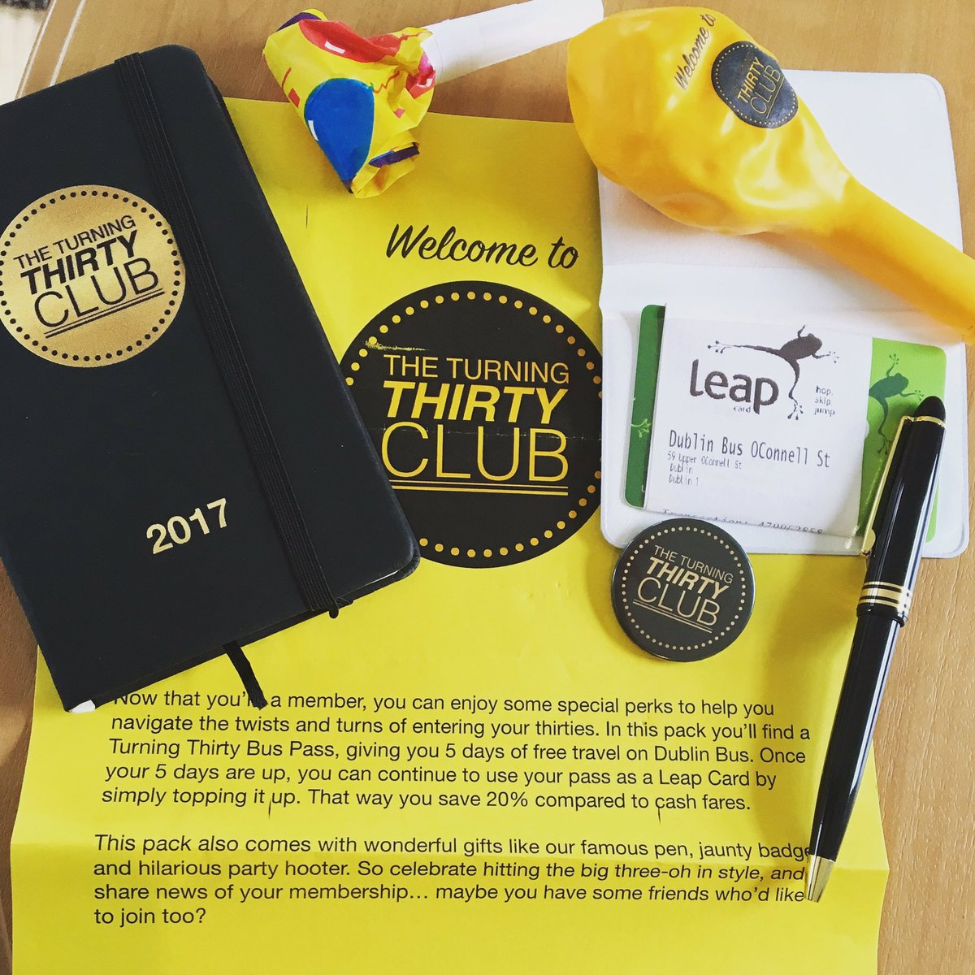
Turning 30 in 2017

Slide 7
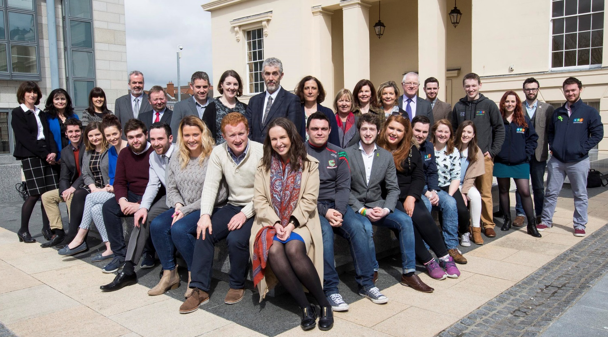
National Collaboration
Higher Education Authority
Quality & Qualifications Ireland
Union of Students in Ireland
Notes:
The National Student Engagement Programme was established by the Higher Education Authority, Quality and Qualifications Ireland and the Union of Students in Ireland in 2016. While the national bodies have always worked well together this is the first time they have partnered on a project.

Slide 8
Student Engagement in Ireland
In 2014, the Higher Education Authority (HEA) established a representative group to explore best practice in relation to student engagement in higher education institutions and to propose a set of principles which would assist institutions in this area.
The report Enhancing Student Engagement in Decision-Making was published in April 2016.
Notes:
The establishment of NStEP was preceded by the Working Group on Student Engagement in Irish Higher Education. This group completed extensive research and developed 10 principles for student engagement.

Slide 9
10 Principles of Student Engagement
Democracy
Student as partner
Inclusivity and diversity
Transparency
Students as co-creators
Collegiality and parity of esteem
Professionalism and support
Feedback and feedback loop
Self-criticism and enhancement
Consistency
Notes:
The 10 Principles of student engagement provide a framework by which NStEP structures its work. You will see the three drivers at the top of the diagram on the right – HEI as a critical institutions, HEI as a site of democratic citizenship and the HEI as a learning community - and the four domains across the bottom – Teaching & Learning, Quality Assurance, Governance & Management and Capacity Building & Training.

Slide 10
NStEP Objectives
To develop student capabilities to engage in quality enhancement and assurance activities at all levels of the higher education system.
To support institutions in developing processes and activities which support/facilitate the meaningful engagement of students.
To strengthen the value placed on student engagement across Ireland and develop tools and resources to support a common understanding and build effective practice.
To lay the foundations to develop work beyond the pilot phase to inform the implementation of a national student training programme and increase capacity to take work further
Notes:
The work of the NStEP programme fits into theses four objectives. The first objective is being met by the National Student Training Programme, an annual training programme delivered by student trainers to class representatives. The second objective is being met by the Institutional Analysis work stream which is facilitated by sparqs (student partnerships in quality Scotland). The third objective cites the development of tools and resources which is beginning with 5 new projects which I will explain shortly. Finally we will launch a National Network for student engagement which will take us beyond the pilot.

Slide 11
NStEP Work Streams
National Student Training Programme
Institutional Analysis Work Stream
5 Projects
Student/Staff Partnership

Slide 12
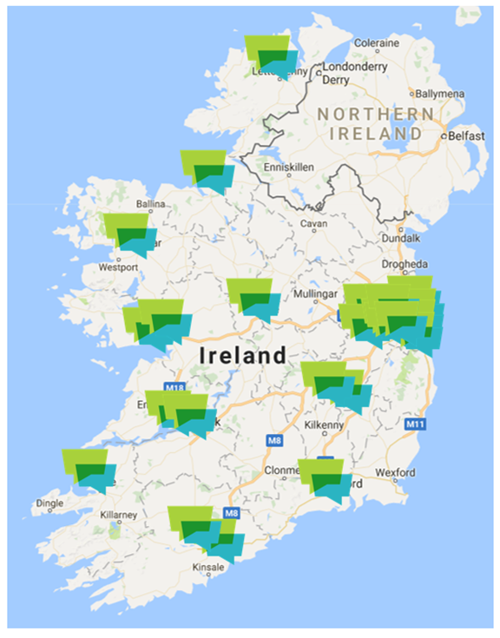
Brief History of NStEP
Apr-Jun
Notes:
NStEP began as a small pilot with 5 HEIs and has now grown across 23 public and private higher education institutions. Our governance includes a steering committee and the national network.

Slide 13
Consultants to NStEP
student partnerships in quality Scotland
Full-time staff in Edinburgh and Inverness
Works with all institutions and students’ associations in the university and college sector. Provides international consultancy.
Scottish Charity - members all sector agencies
Main Funding – Scottish Funding Council
www.sparqs.ac.uk
Notes:
sparqs (student partnerships in quality Scotland) is an agency which, as their name suggests, puts students at the heart of decisions being made about the quality and governance of the learning experience.
sparqs was founded in 2003 and gained charitable status in December 2015. They are funded by the Scottish Funding Council to advance education by promoting an environment where students are able to make a positive and rewarding difference to their own and others' educational experience.
Originally named 'student participation in quality Scotland', in May 2015, they announced a small but meaningful change to our name, changing 'participation' to 'partnerships' reflecting the progress made in the sector since the inception of sparqs. The change did not involve a rebrand, rather a phasing in of our new name 'student partnerships in quality Scotland'.

Slide 14
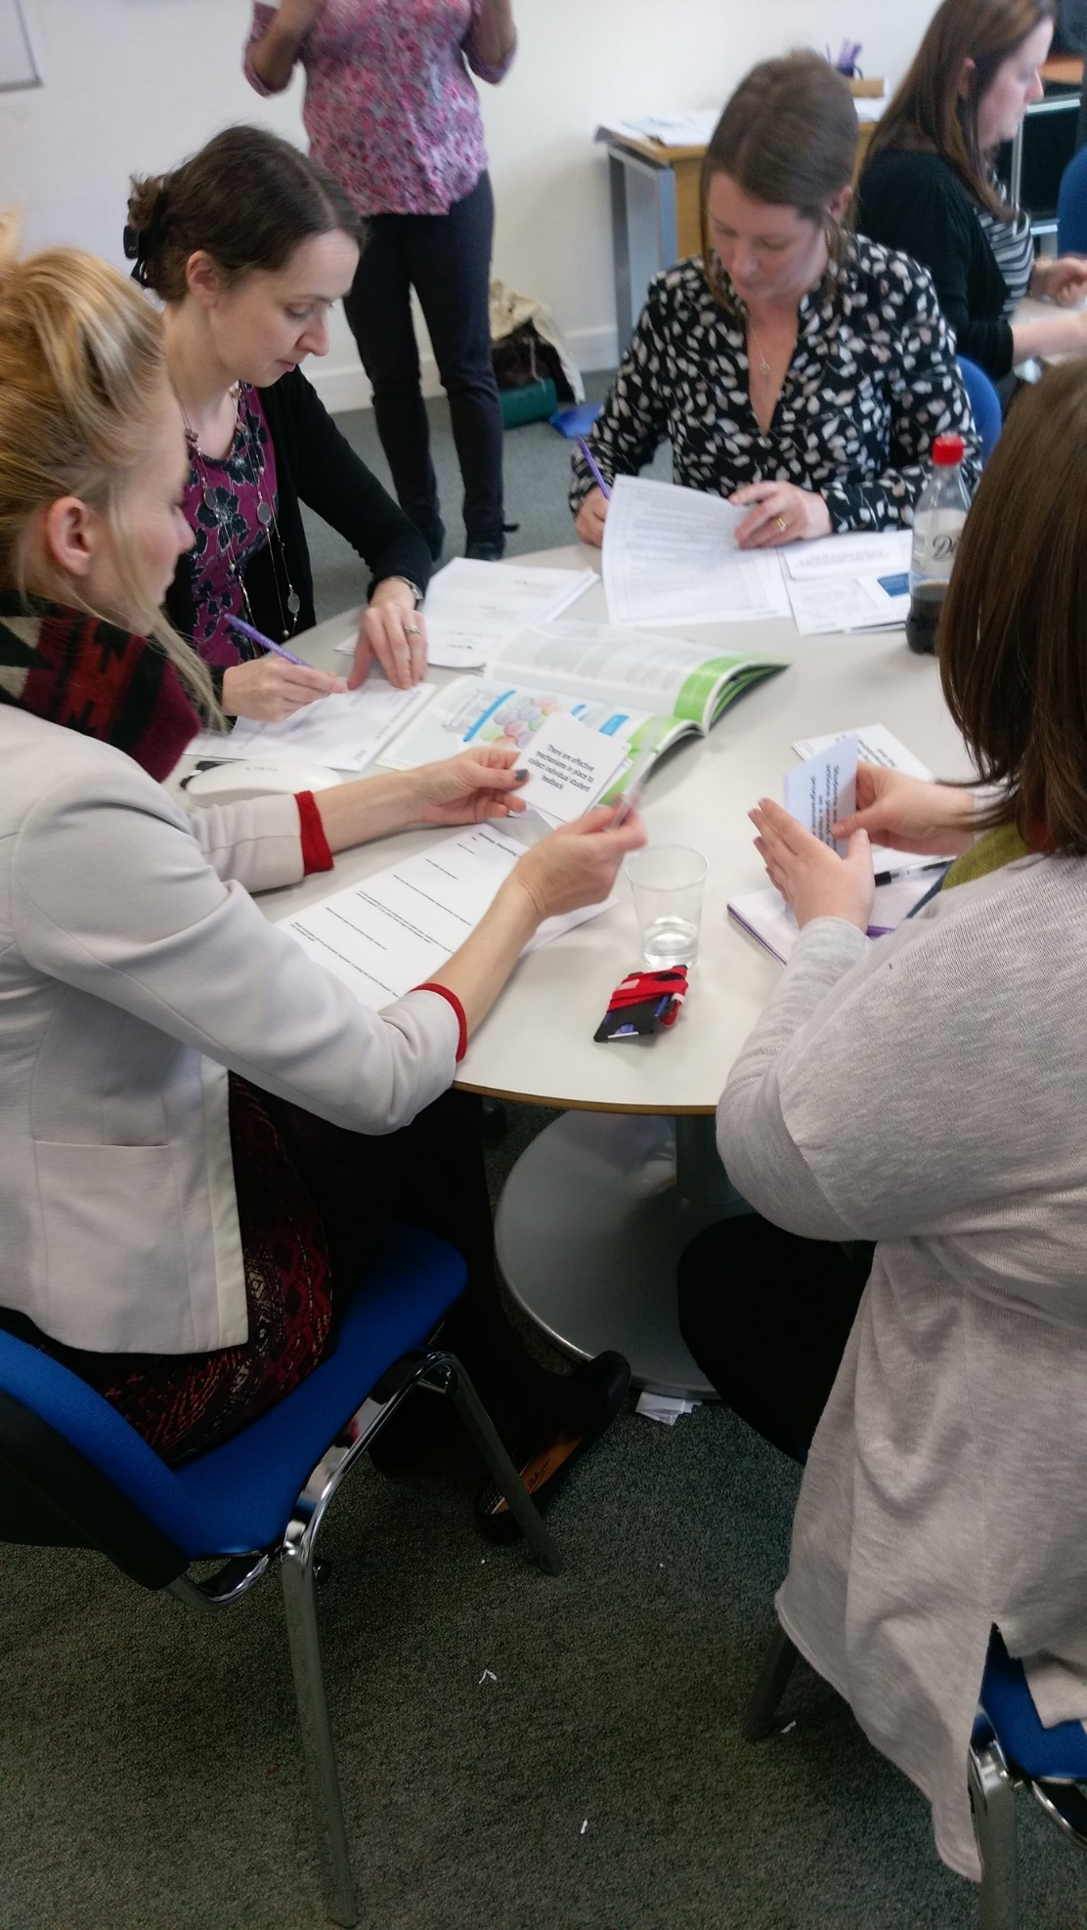
NStEP Activities
Mar-May
Pilot HEIs selected
First meeting of the National Working Group – May 17th
Jun-Oct
Students’ Union Training sessions on Student Engagement and Class Reps
Student Trainers attend sparqs residential training
Oct - Dec
Class Rep Training Programme Delivered
Institutional Analysis Sessions begin
Programme Launched in April
Student trainers recruited
Second meeting of the National Working Group Meeting – Nov 10th
National Event for Students’ Union Officers Nov 3rd
Class Rep Training Programme designed
Dec - Mar
Completion of the Institutional Analysis events
Analysis of the Institutional Analysis Outputs
Recruitment call for Student Trainers issued
Digital Badge Development begins
Review of Class Rep Training Feedback
Selection of the 5 new Projects from the pilot analysis outputs
Induction event for HEIs joining the National Student Training Programme Apr 6th
Student Trainers Recruited
Induction meetings for 2017 Analysis events begin Jun 13th
2016
2017
Apr - Jun

Slide 15
NStEP Work Streams
National Student Training Programme
Institutional Analysis Work Stream
5 Projects
Student/Staff Partnership
Notes:
Let’s take a look at the structure of the student training programme.

Slide 16
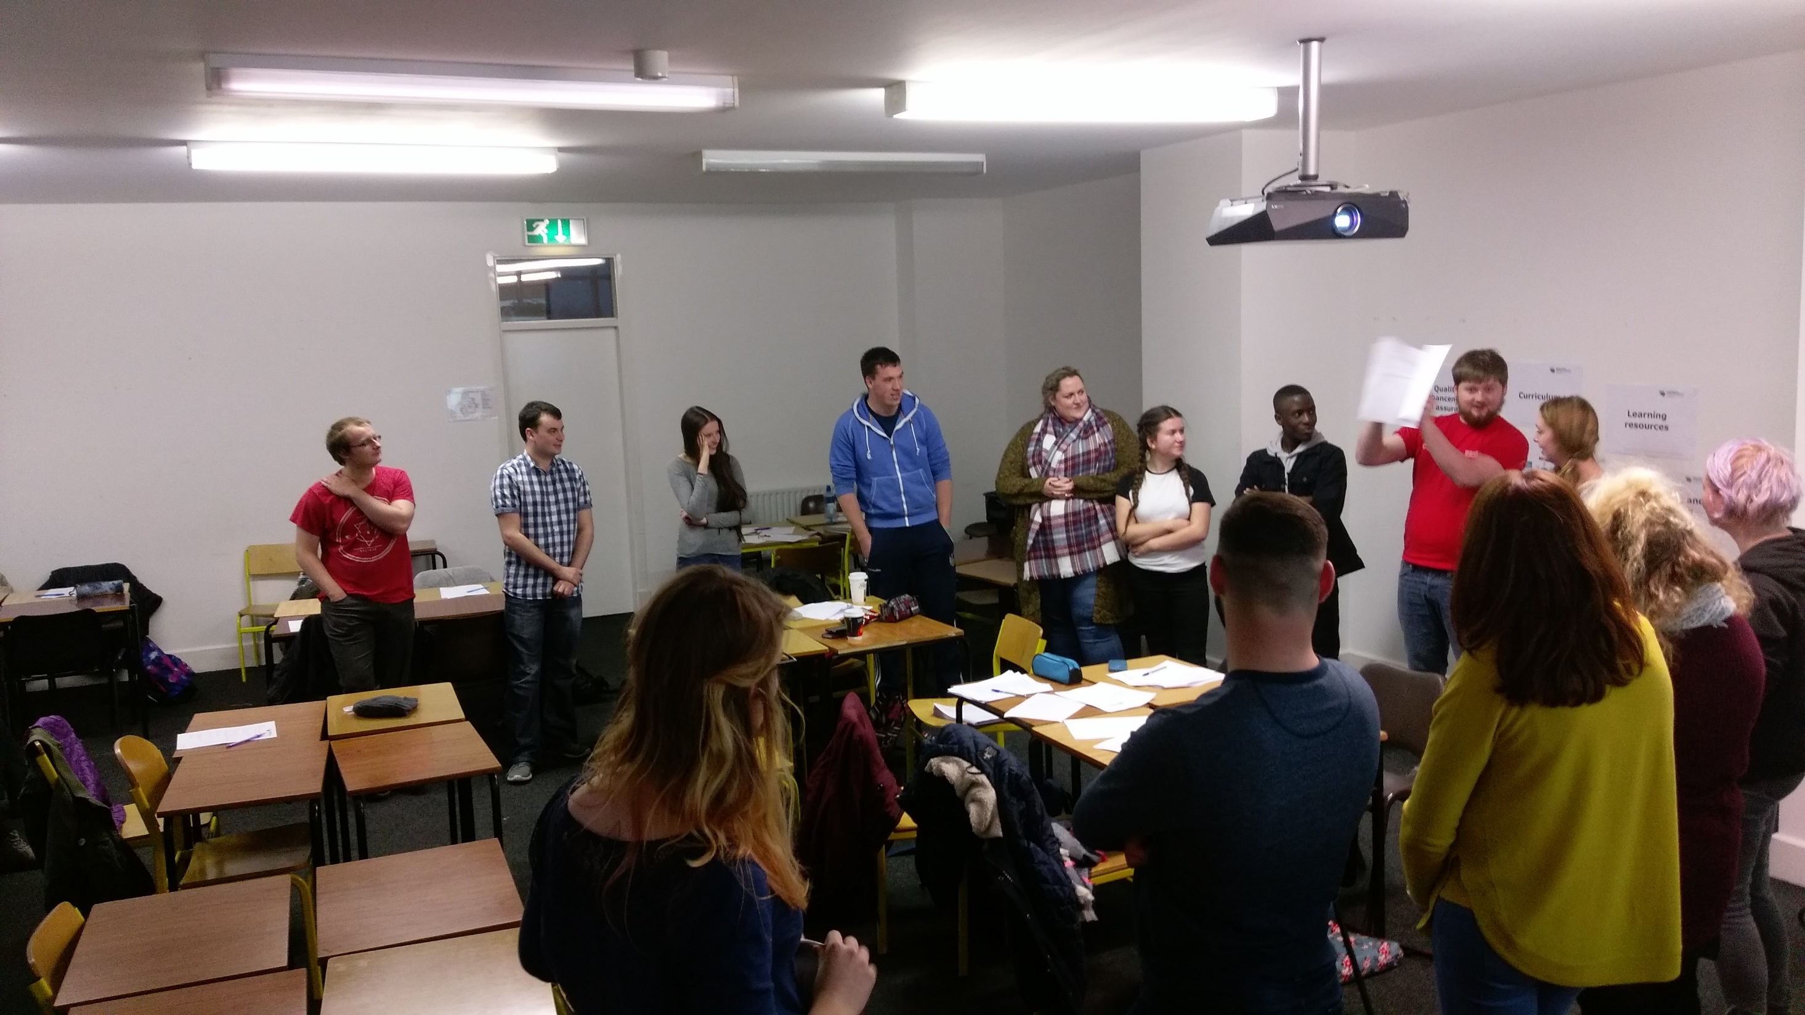
National Training Programme
1. Introduction to the training and NStEP pilot
2. The Class Rep role and why it’s important
3. The Student Learning Experience
4. Gathering student opinion
5. Effective feedback
6. Developing solutions
7. Making change happen
8. Closing the loop

Slide 18
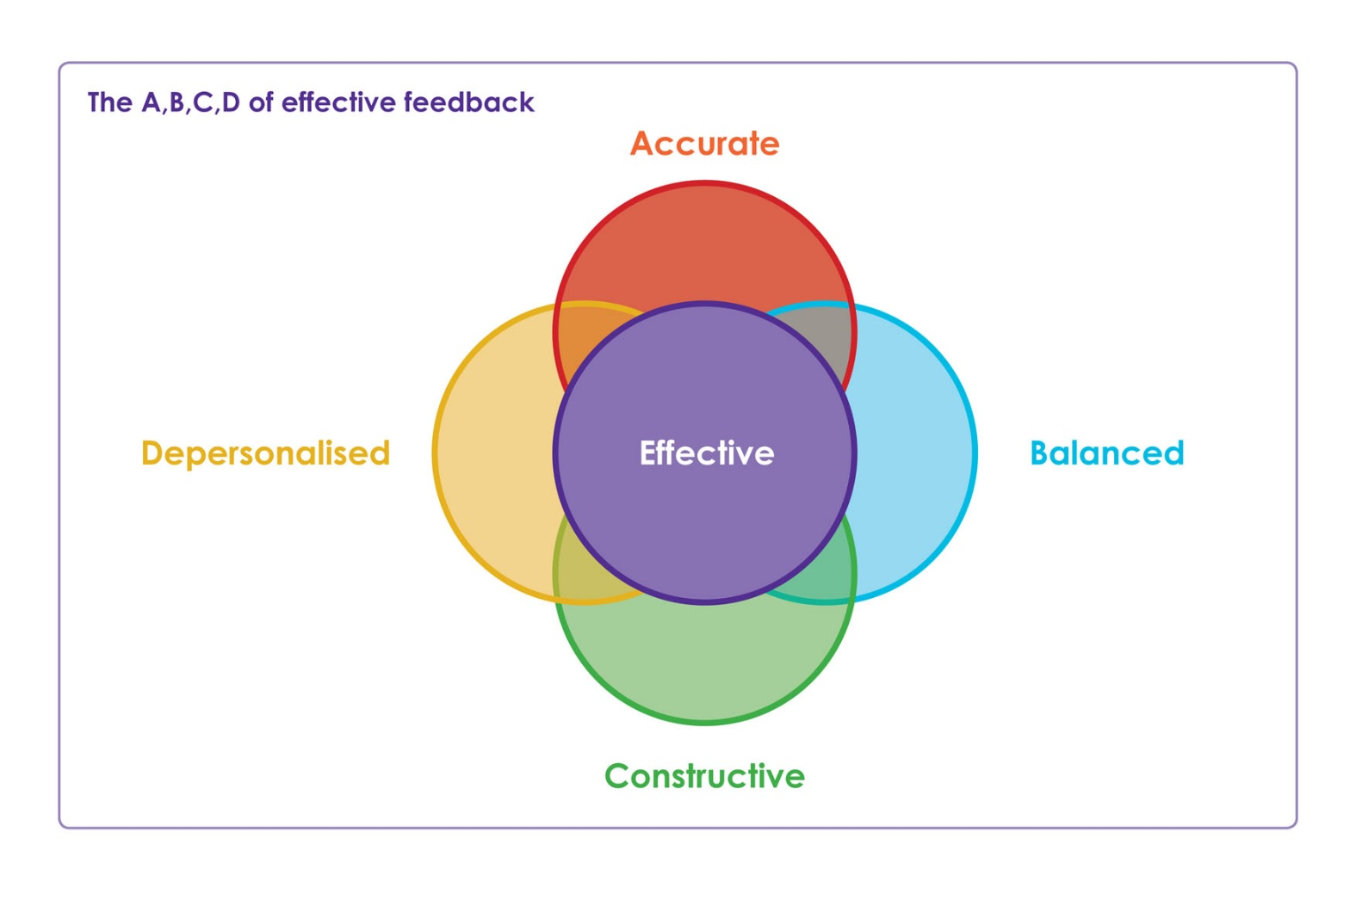

Slide 19
2016 Training Programme Delivery
HEI | Sessions | Time | Participants | Value Rating Average
NUI Galway | 5 | Early Oct to Early November | 169 | 4.3
Letterkenny IT | 5 | Late October to Early December | 77 | 4.5
Cork IT | 3 | Early November | 48 | 4.3
Waterford IT | 5 | Late November | 55 | 4.5
National College of Ireland | 1 | Early December | 17 | 4.2

Slide 20
About the 2016 participants

Slide 21
Understanding of the Role

Slide 22
Understanding of Mechanisms

Slide 23
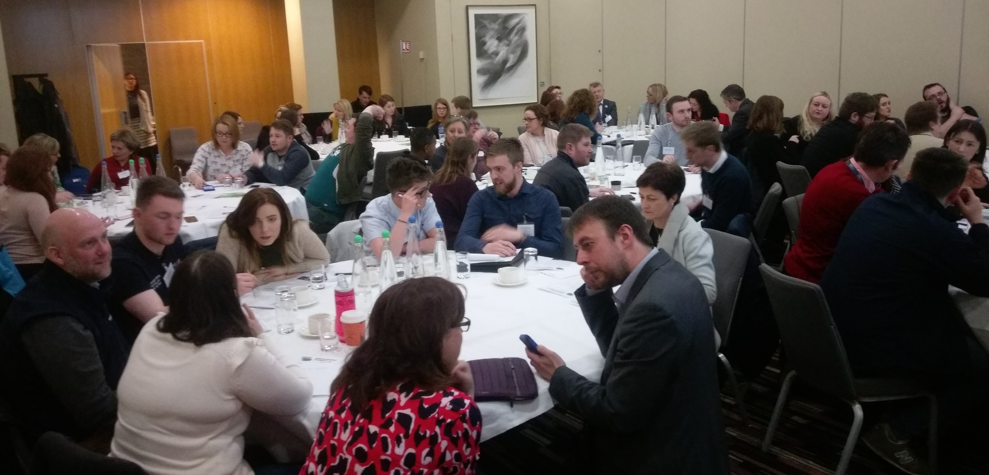
What’s next?
April 6th 2017
Induction Event
11 Trainers
23 Institutions
Oct – Dec Delivery
#NStEPRollOut

Slide 24
NStEP Work Streams
National Student Training Programme
Institutional Analysis Work Stream
5 Projects
Student/Staff Partnership

Slide 25
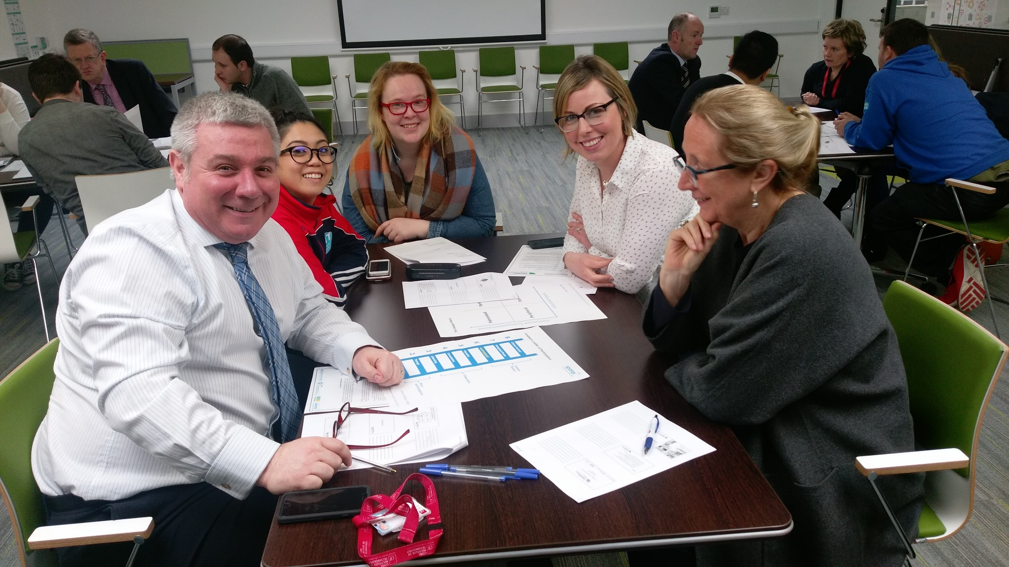
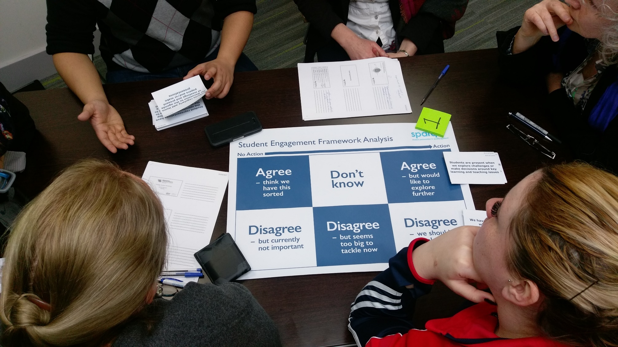
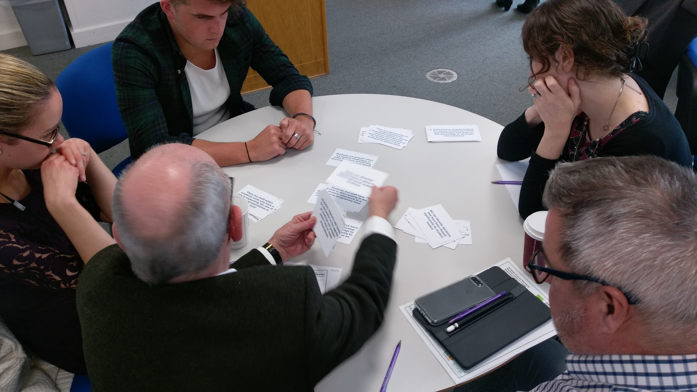
NStEP Institutional Analysis

Slide 26
A Ladder of Citizen Participation - Sherry R Arnstein
Cadogan Matrix of Institutional / Students’ Union Relationships

Slide 27
NStEP Institutional Analysis Schedule
2016/2017 Pilot | 2017/2018 | 2018/2019
National College of Ireland | Dublin Institute of Technology | Institute of Technology Carlow
Letterkenny Institute of Technology | Griffith College Dublin | Athlone Institute of Technology
NUI Galway | Dublin City University | Carlow College
Waterford Institute of Technology | Institute of Technology Sligo | Limerick Institute of Technology
Cork Institute of Technology | Maynooth University | Institute of Art, Design & Technology
 | Institute of Technology Tralee | Galway-Mayo Institute of Technology

Slide 28
NStEP Work Streams
National Student Training Programme
Institutional Analysis Work Stream
5 Projects
Student/Staff Partnership

Slide 29
5 New Projects
The Role and Recruitment of Class Representatives
The Design, Review and Delivery of Programmes
Student Feedback Opportunities, Data and Follow Up
Students in formal system level procedures, strategy and decision making
Staff Roles and Capacity Building

Slide 30
Quality Reviewers Pool

Slide 31
T&L Pool - Call Open

Slide 32
Event for Students’ Unions

Slide 34
10 Principles of Student Engagement
Democracy
Student as partner
Inclusivity and diversity
Transparency
Students as co-creators
Collegiality and parity of esteem
Professionalism and support
Feedback and feedback loop
Self-criticism and enhancement
Consistency
Notes:
The 10 Principles of student engagement provide a framework by which NStEP structures its work. You will see the three drivers at the top of the diagram on the right – HEI as a critical institutions, HEI as a site of democratic citizenship and the HEI as a learning community - and the four domains across the bottom – Teaching & Learning, Quality Assurance, Governance & Management and Capacity Building & Training.

Slide 35
Go raibh míle maith agaibh agus go n-éirí an bóthar libh
A thousand thank yous and may the road rise to meet you (Good luck)
usi.ie/nstep
@NStEPie
cat.odriscoll@usi.ie

