Slide 1

Student Representation at Victoria University of Wellington
Tuesday 27th October 2015
Rick Zwaan | President
Victoria University of Wellington Students’ Association

Slide 2


Notes:
Introduction slide – about me VUWSA President – BSc Student ben on VUWSA Exec for a few years

Slide 3
Importance of Effective Student Representation
Improves quality
Enhances engagment with learning
Increases connection between students and the university
Improves a sense of community and belonging
Creates effective communication channels
Addresses issues before they become bigger
Policy complience

Slide 4
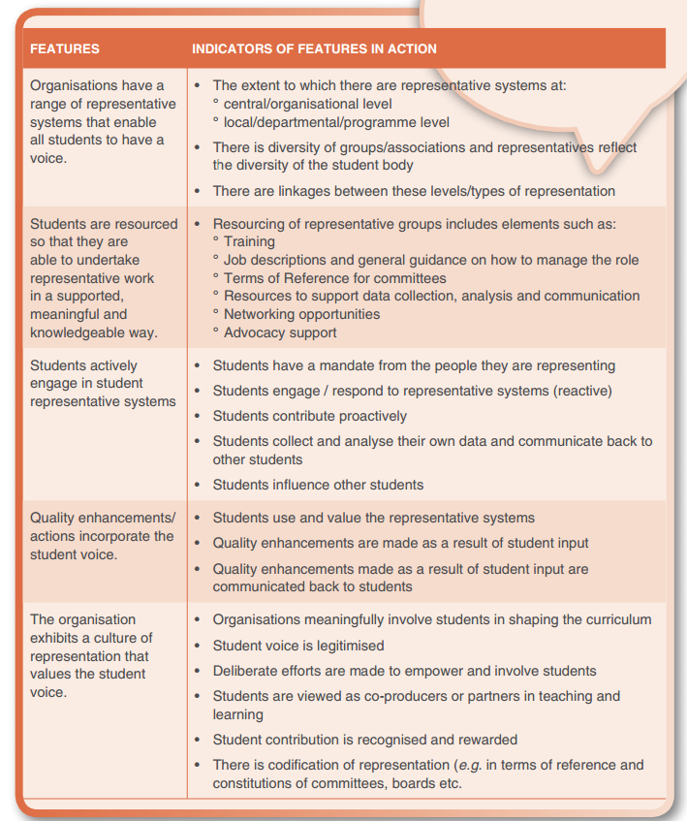
Source:
AKO Aotearoa
‘Using the Student Voice to Improve Quality’
akoaotearoa.ac.nz

Slide 5





CLASS REPRESENTATIVES
General feedback, consultation, programme reviews, focus groups
UNIVERSITY COUNCIL
VUWSA PRESIDENT & STUDENT ELECTED AT LARGE
ACADEMIC BOARD
Advises the University Council on matters relating to courses of study, awards, and other academic matters
VUWSA PRESIDENT, ACADEMIC VP & STUDENT MEMBER
VUWSA PRESIDENT & ACADEMIC VP
ACADEMIC COMMITTEE
Reviews proposals for new qualifications and courses and monitors reviews of academic programmes.
FACULTY DELEGATES
FACULTY BOARDS
Deal with all matters concerning the maintenance of academic quality and any other academic matters at a Faculty level

Slide 6
Student Voice in Practice at Victoria
Student representatives at all decision making levels
Administered by VUWSA in partnership with Victoria
Training and on-going support provided by dedicated VUWSA staff
In Trimester Two 2015 98% of all undergradute courses had class reps
729 Class Reps in Trimester Two 2015
Participation at every Faculty Board Meeting, Academic Committee and Academic Board Meetings
Involvement with every Programme Review and Graduating Year Reviews
Consulation on major policy or programme changes

Slide 7

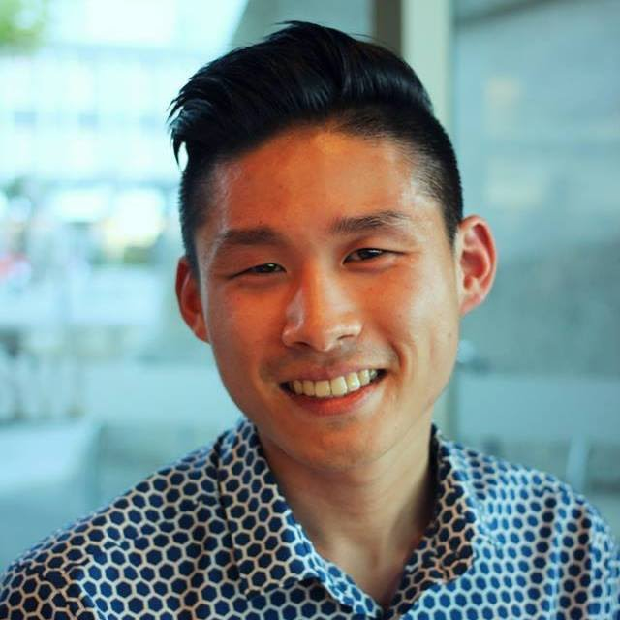



Supporting Effective Student Voice: The Team
RICK ZWAAN |PRESIDENT
JONATHAN GEE | ACADEMIC VICE PRESIDENT
ELLEN HUMPHRIES | EDUCATION OFFICER
GEMMA SWAN | STUDENT REPRESENTATION COORDINATOR
KATE NICKELCHOK | STUDENT ADVOCATE

Slide 8
Supporting Student Voice: Training Reps
Every class rep is offered training each trimester
Handbook provided to every class rep
Training Covers:
  What the role is
  How to deal with issues
  Where to get help
  General overview of important policies
  Introduces key staff people (both VUWSA and VUW)

Slide 9
Supporting Student Voice: On-going support
Dedicated staff member to help class reps deal with tricky issues
Independent Advocate to deal with serious issues
Pre-Meets with delegates before Faculty Board, Academic Committee and Academic Board meetings
Funding available for class parties or iniatives

Slide 10


Slide 11

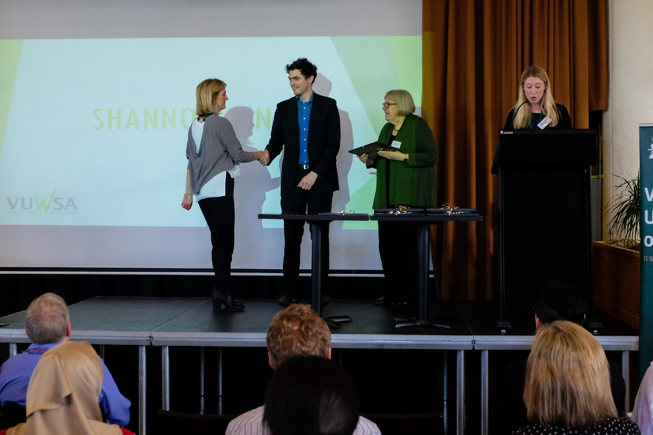
Supporting Student Voice: Celebrating Success

Slide 12
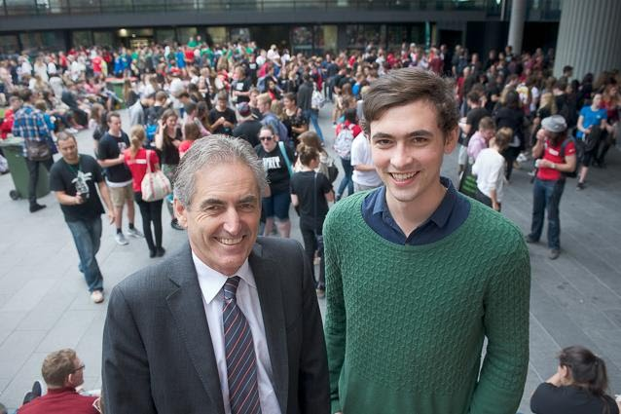
Supporting Student Voice: Importance of Partnership

Slide 13
Supporting Student Voice: Importance of Partnership
Advisory Committee on the Student Services Levy (ACSSL)
ACSSL is a joint committee with two VUW and two VUWSA members
Jointly sets and oversees the Student Services Levy ($712 compulsory fee)
Involves students meaningfuly in high level decisions

Slide 14
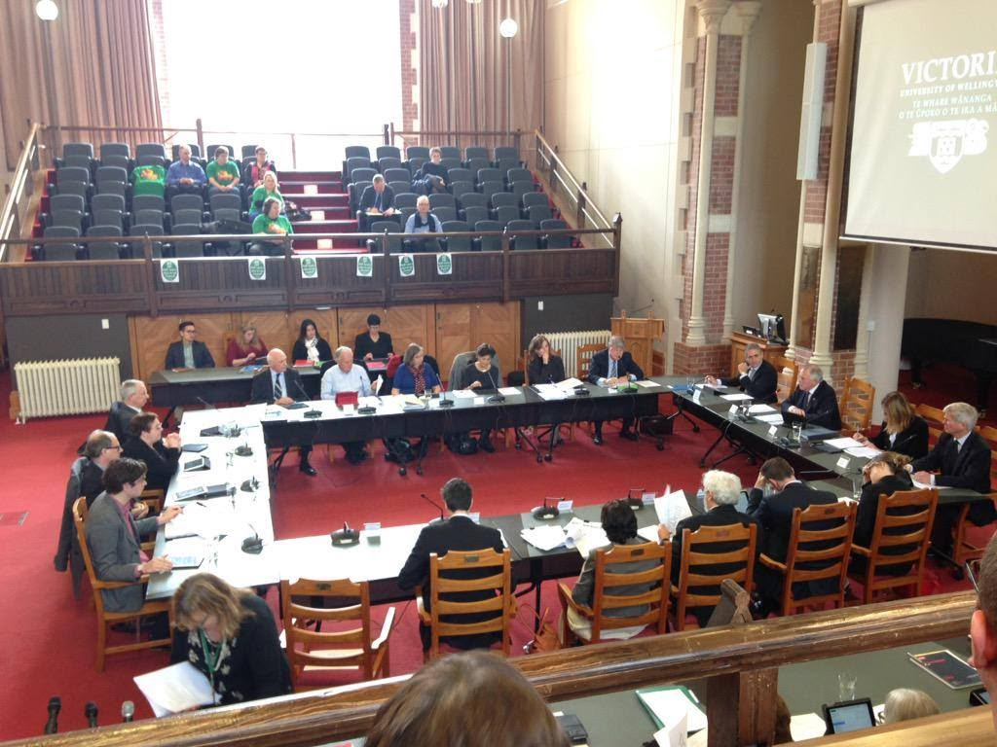
Supporting Student Voice: Importance of Independence

Slide 15
Challenges
Buy in – students & staff
Support and resourcing
Institutional culture of truelly valueing student voice
Class reps at Post Graduate level

